Slide 1
Design of a Preliminary Family of Airfoils for High Reynolds Number Wind Turbine Applications
Cody Karcher*
California State University, Long Beach
David Maniaci, Chris Kelley, Alan Hsieh, and Nate deVelder
Sandia National Laboratories
Anurag Gupta
National Renewable Energy Laboratory
Sandia National Laboratories is a multimission laboratory managed and operated by National Technology and Engineering Solutions of Sandia LLC, a wholly owned subsidiary of Honeywell International Inc. for the U.S. Department of Energy’s National Nuclear Security Administration under contract DE-NA0003525.
SAND2025-00716C

Slide 2
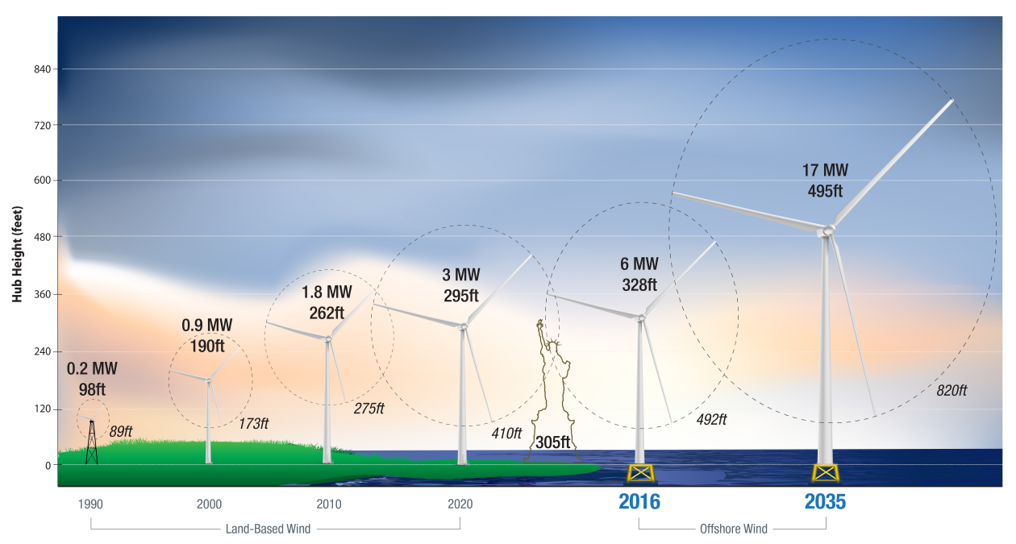
Wind turbines have significantly increased in size over time
https://www.energy.gov/eere/articles/wind-turbines-bigger-better

Slide 3
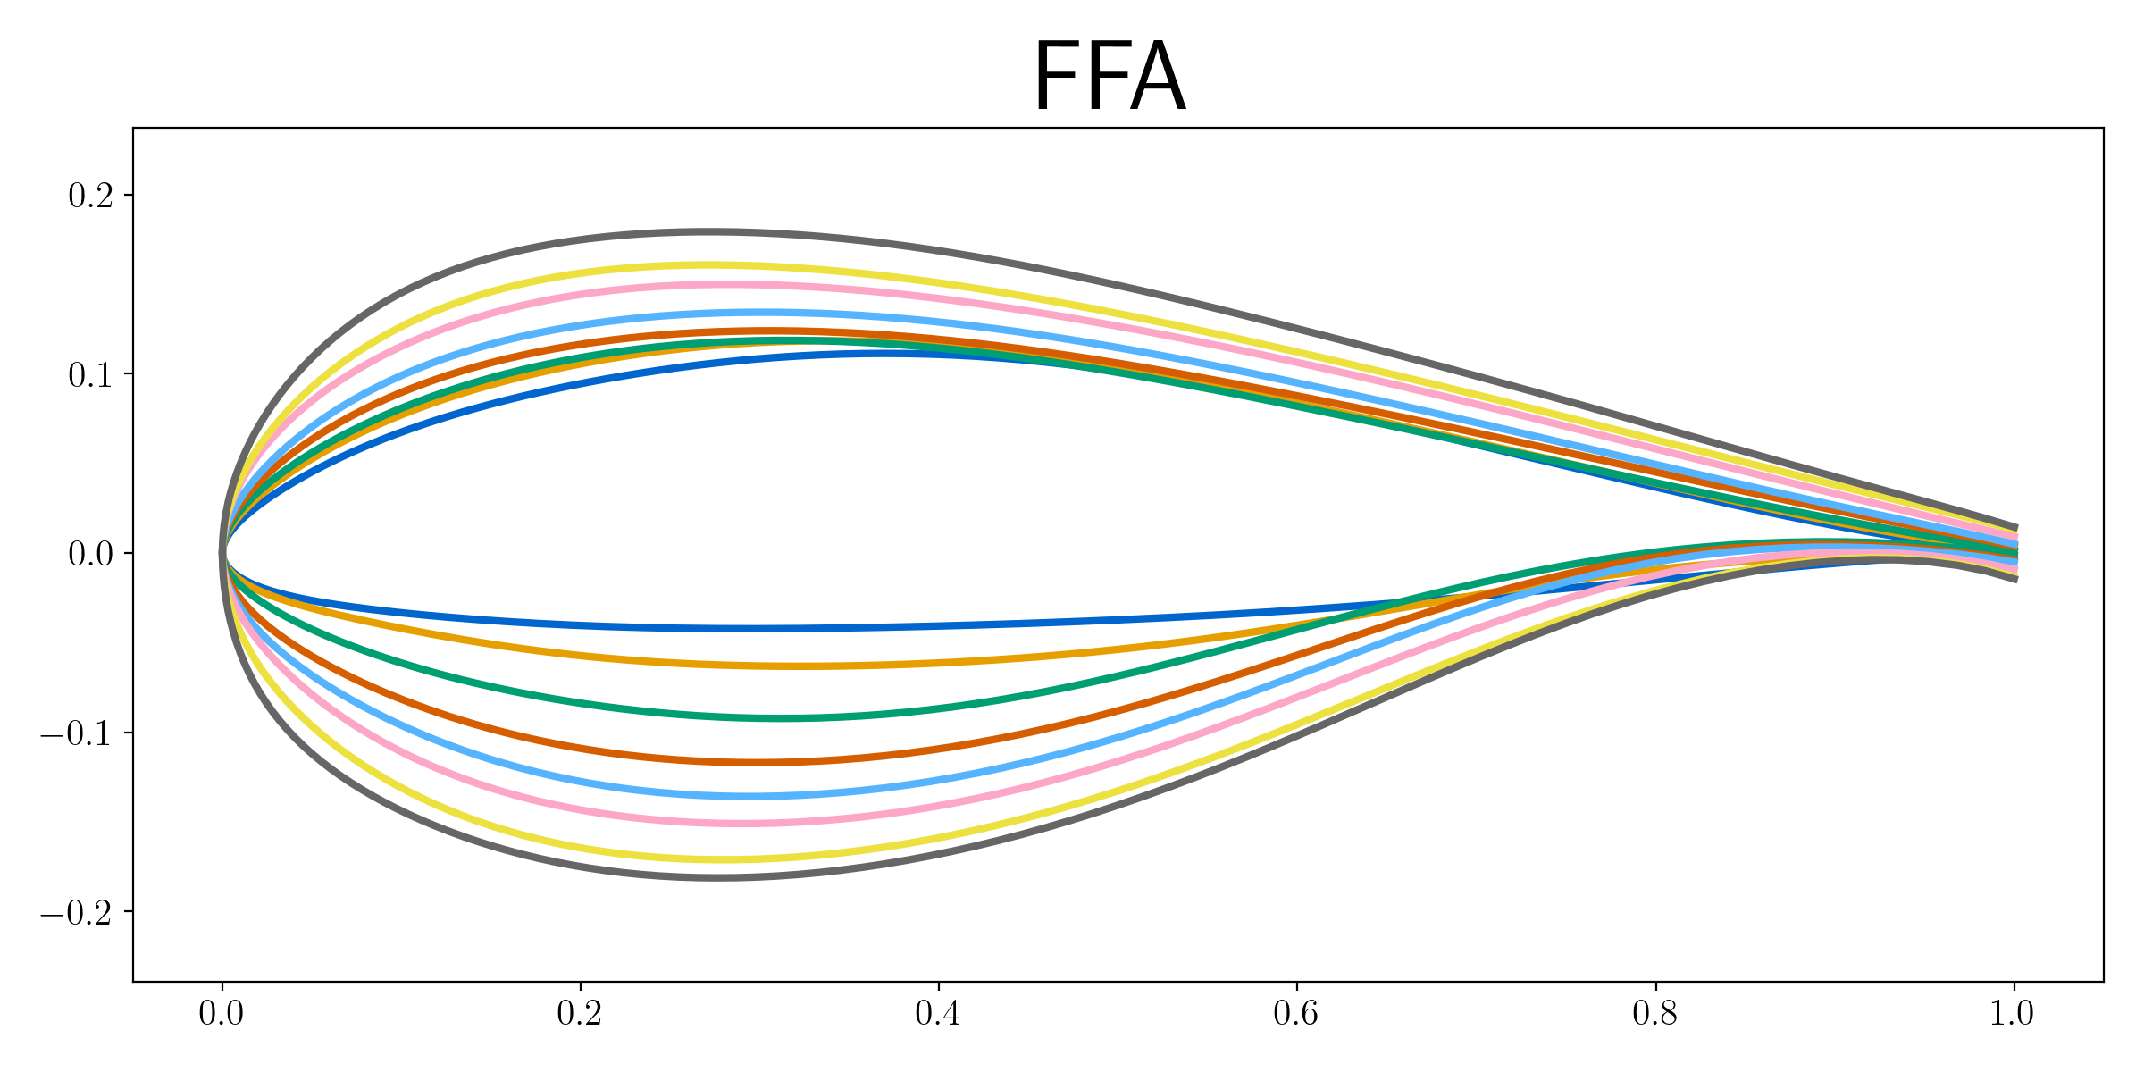
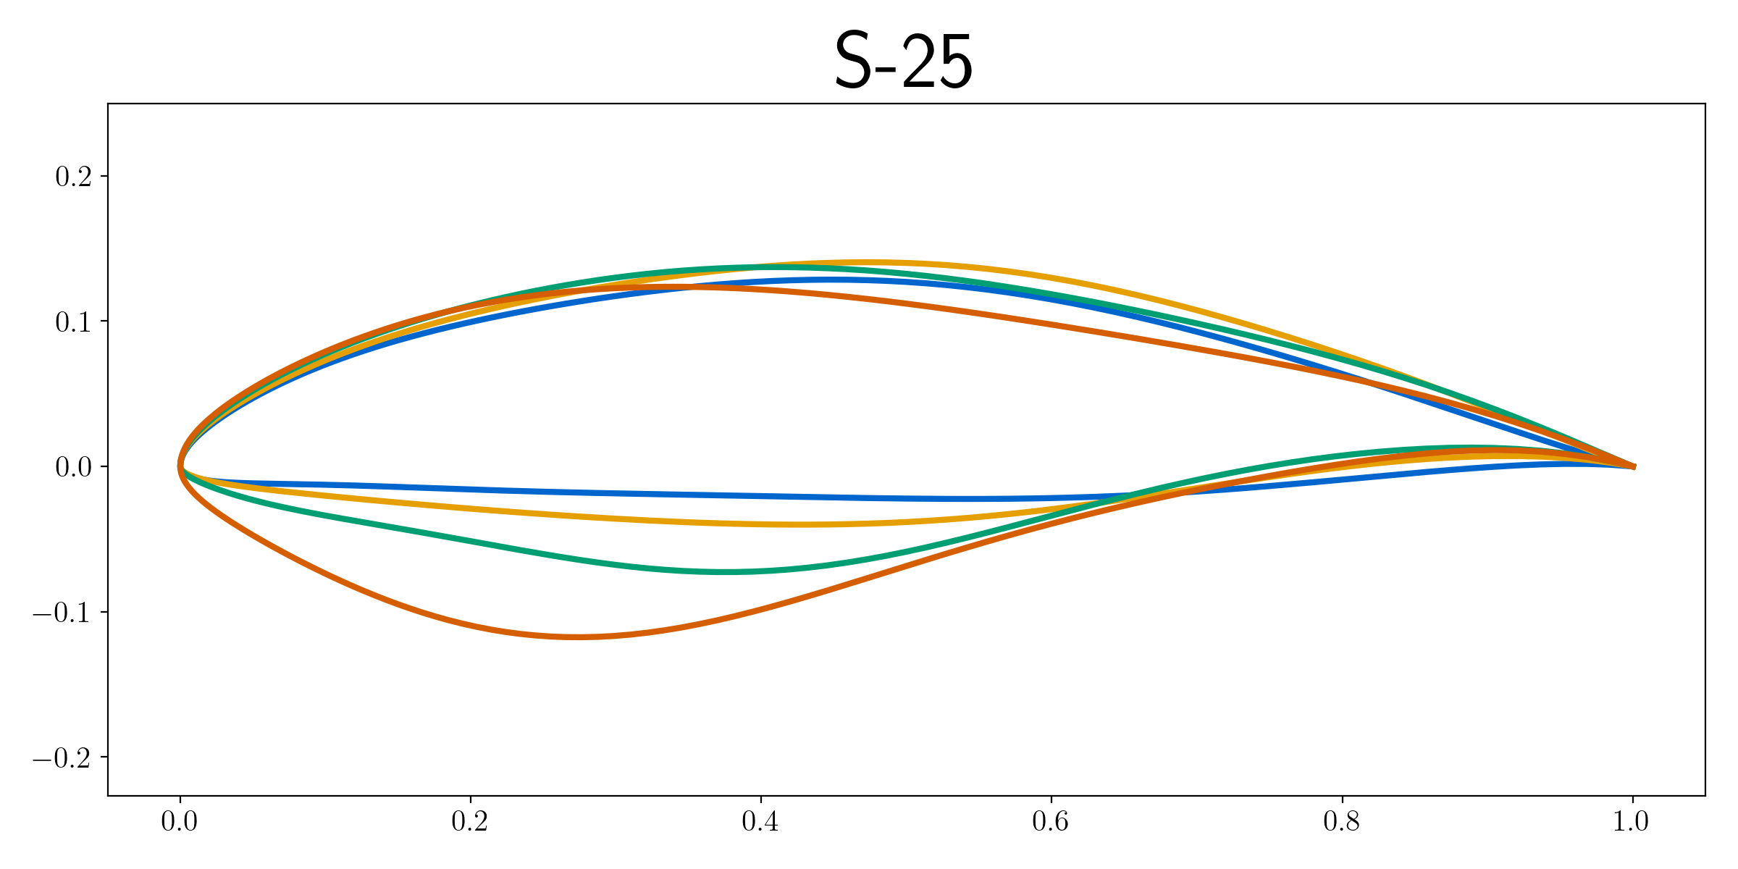
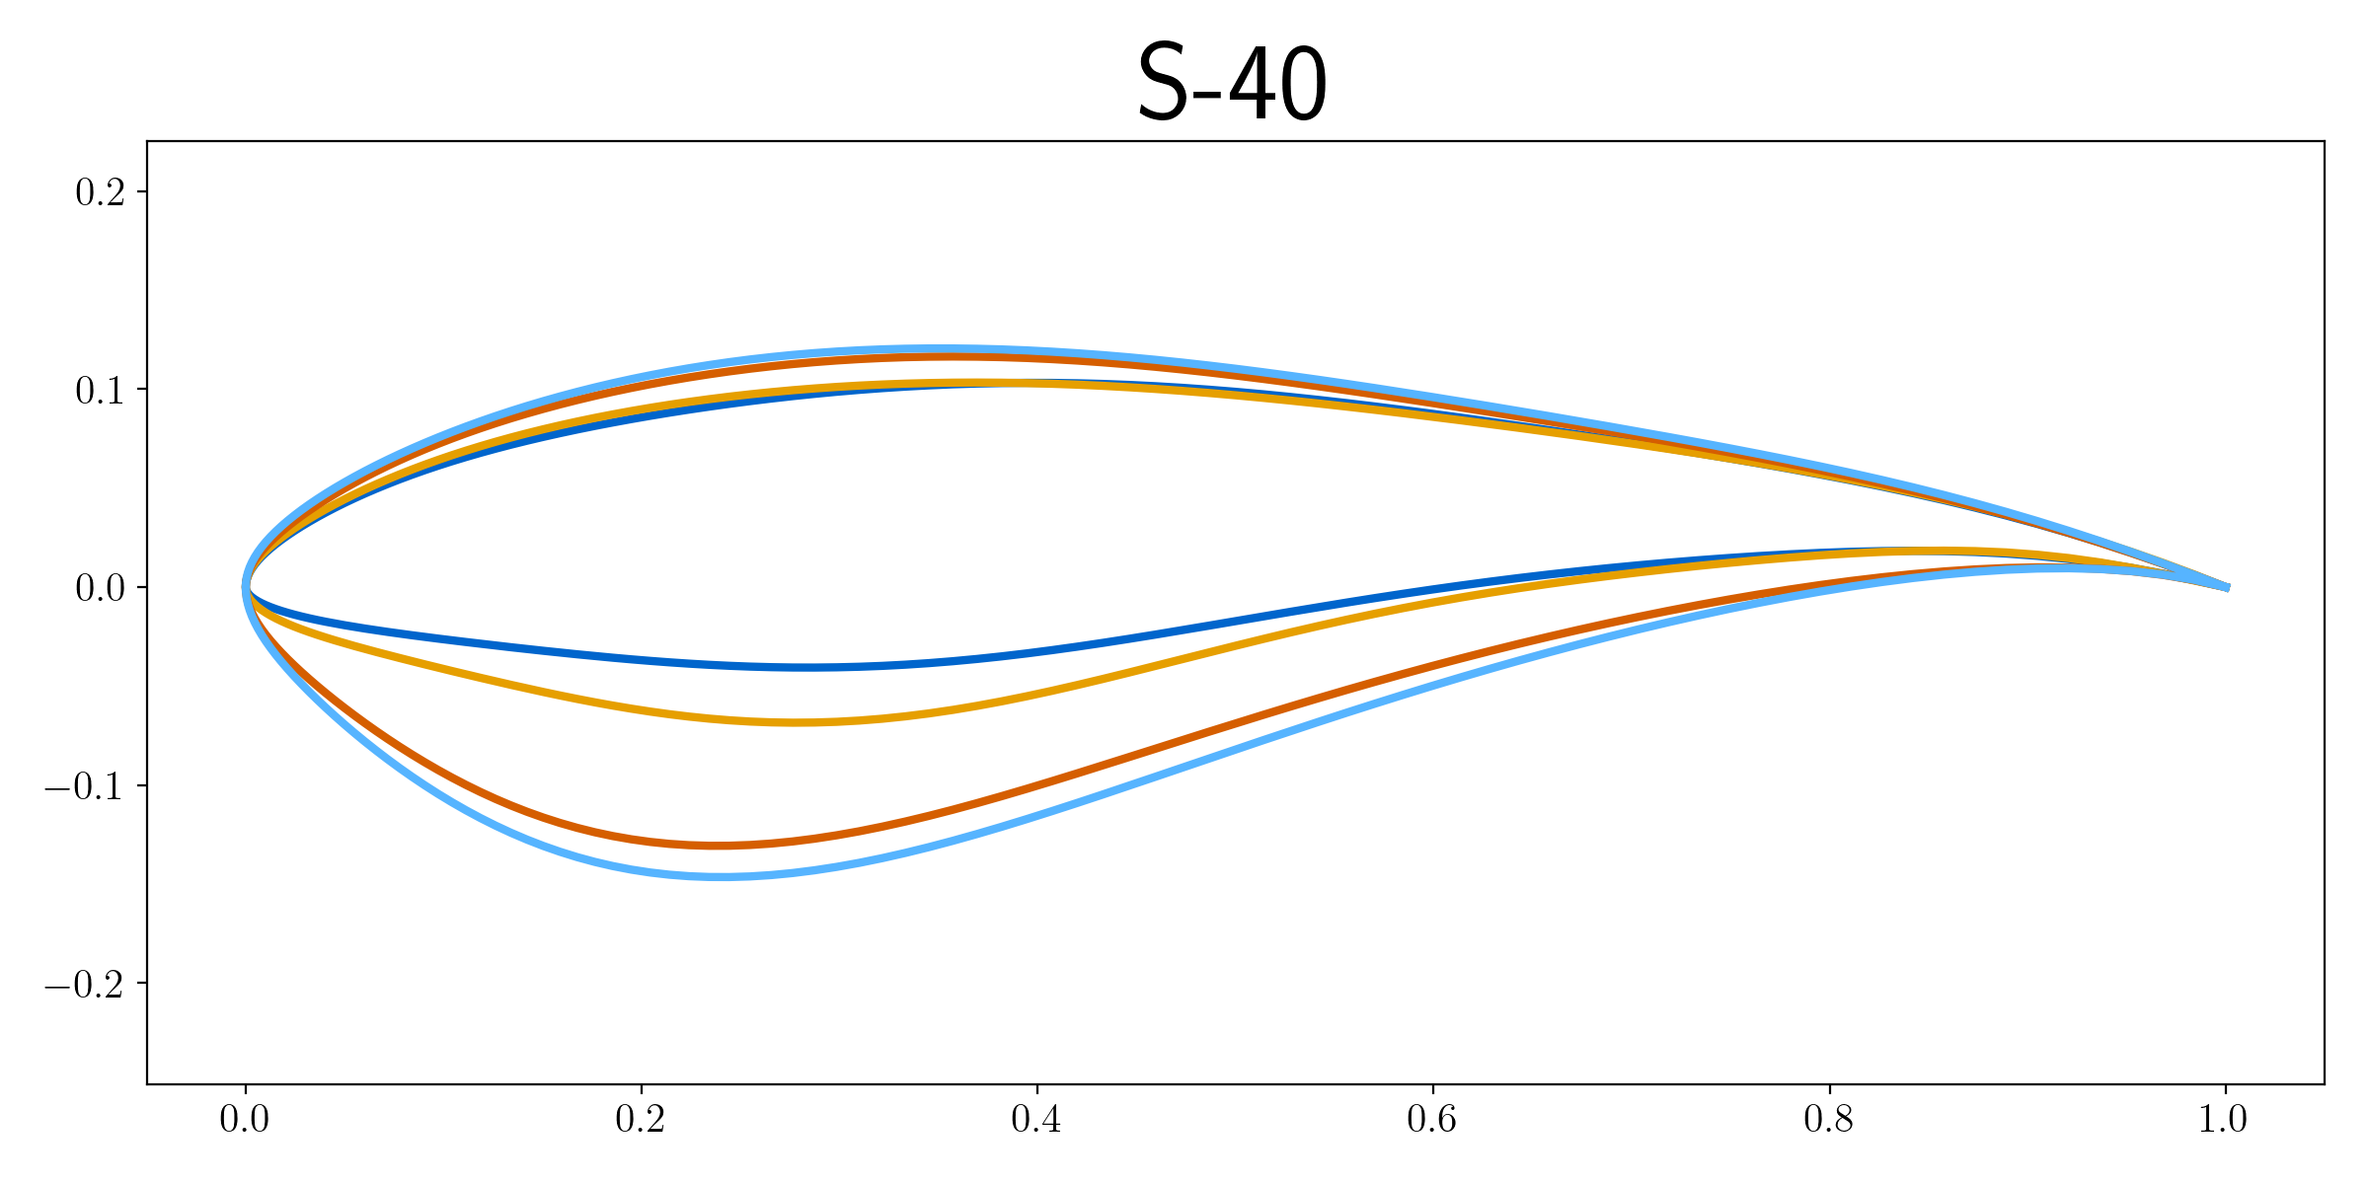
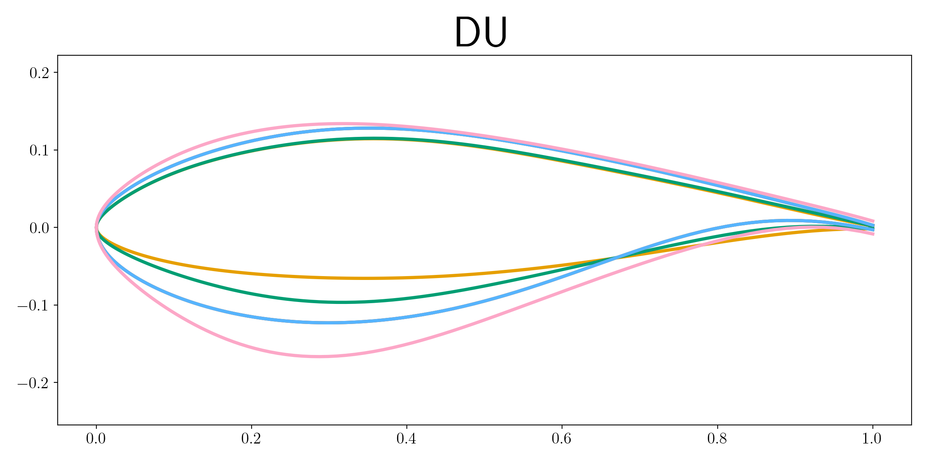
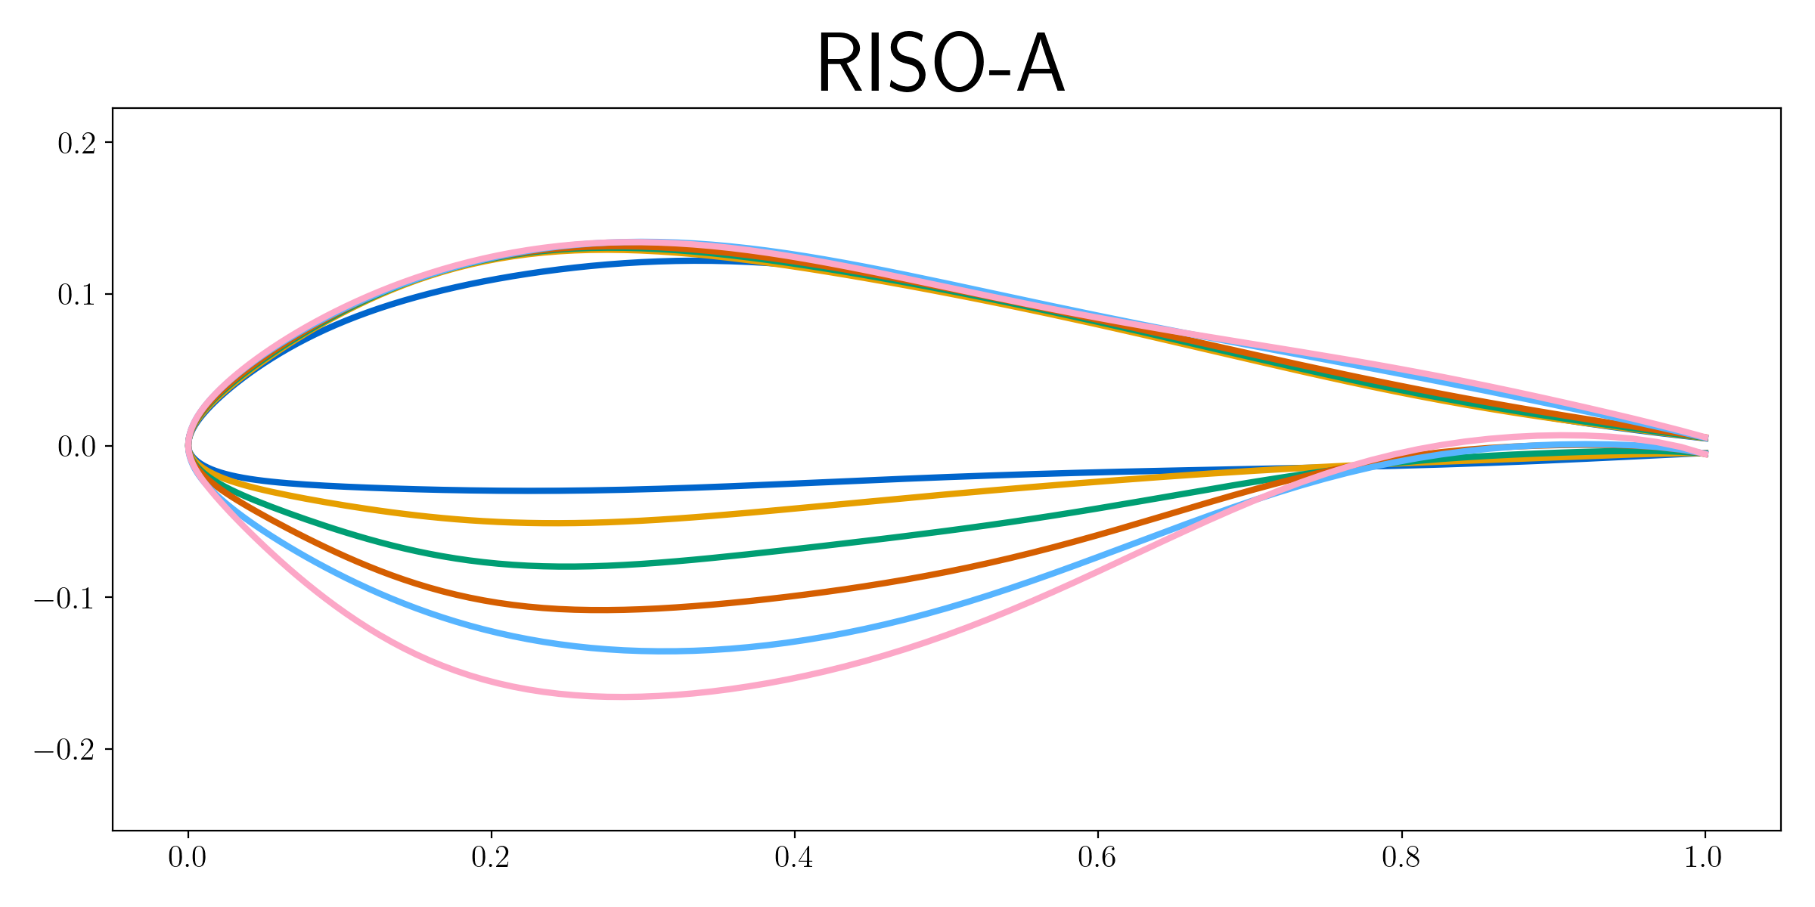
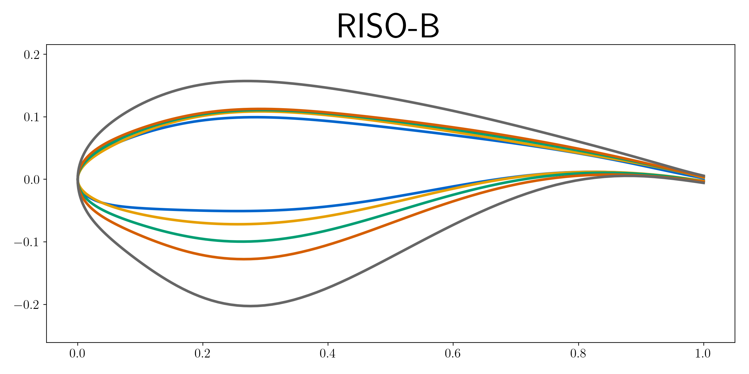
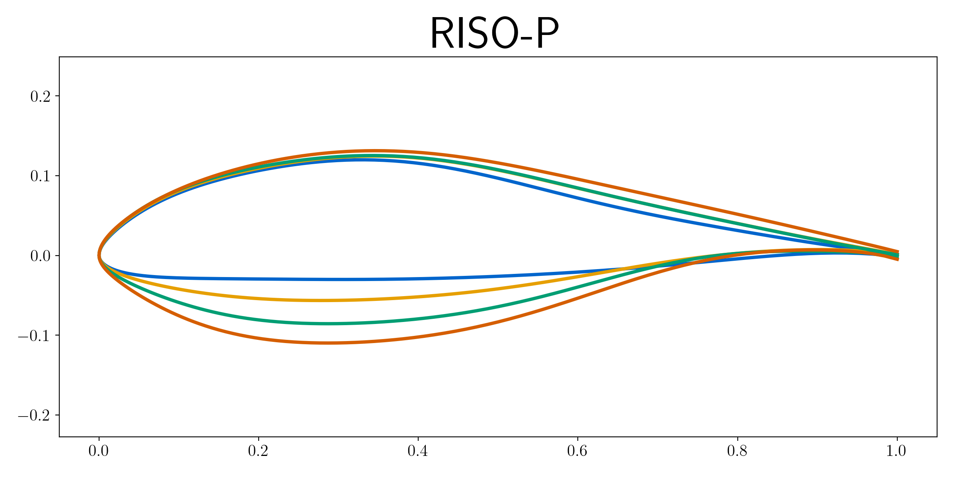
Some airfoils exist, but do not match the current need
Notes:
FFA airfoils are designed for a much lower Re regime and sacrifice performance (similar with all airfoils)

Slide 4
There are also access issues for many of the best airfoils
Fully Open Source
Not Open Source
(approximated from images in the literature)
Notes:
FFA airfoils are designed for a much lower Re regime and sacrifice performance (similar with all airfoils)
S-series Airfoils had significant spar offsets, complicates spar integration
Remaining airfoils are not open source (although some are shared by request, such as DU airfoils)

Slide 5
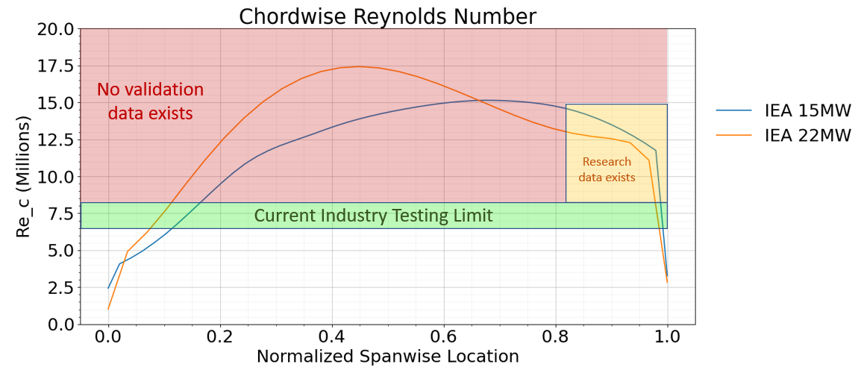
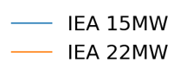
This increase in size has pushed us into new physics regimes
Design range FFA airfoils

Slide 6
But these airfoils are not designed for this task…
Design range FFA airfoils

Slide 7
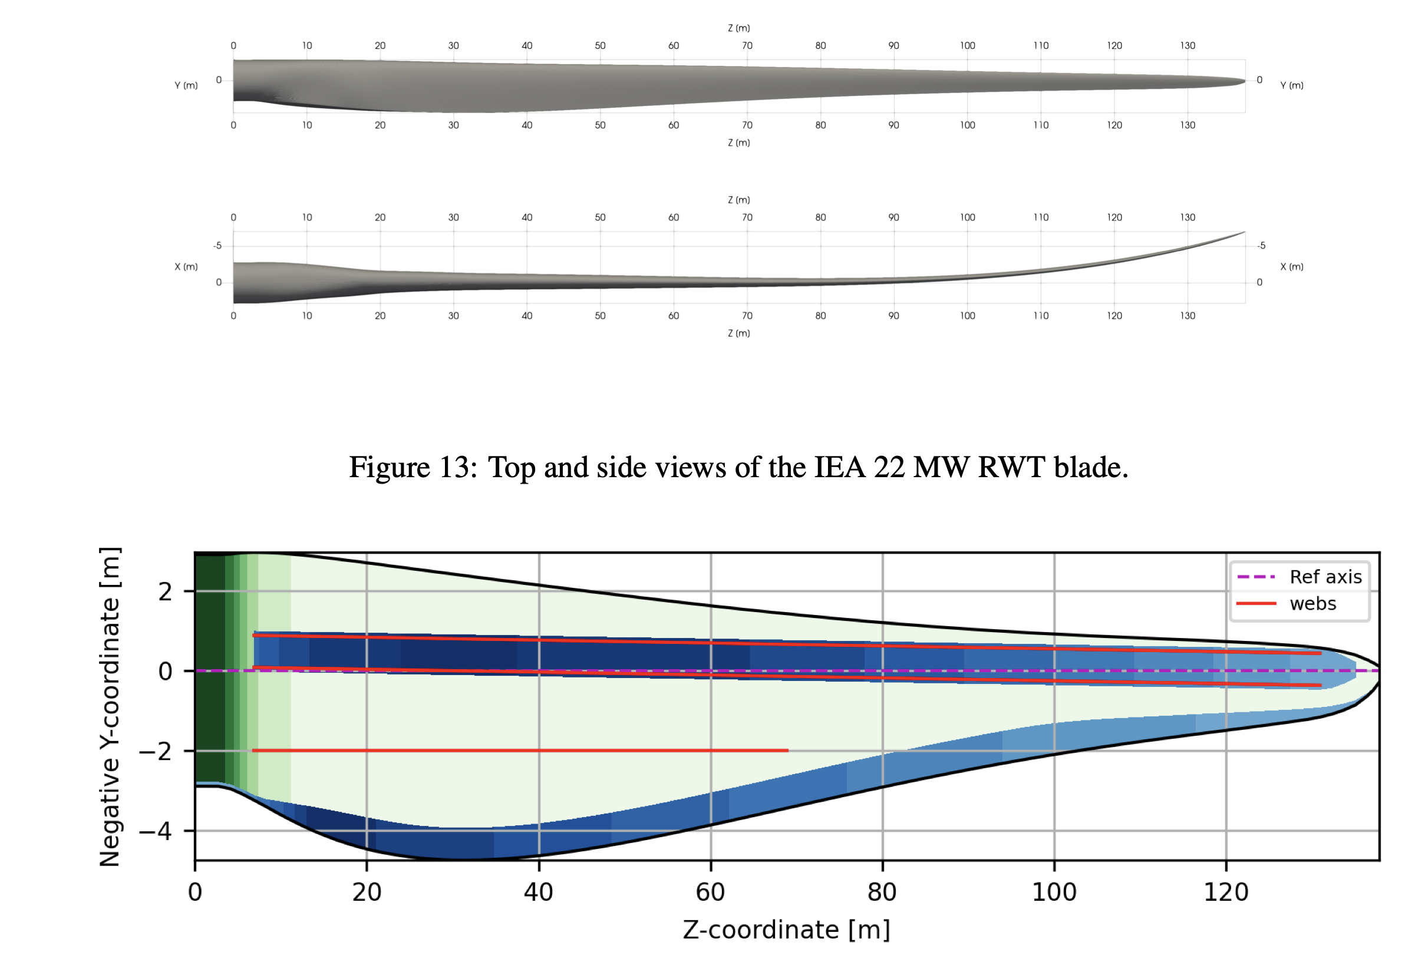
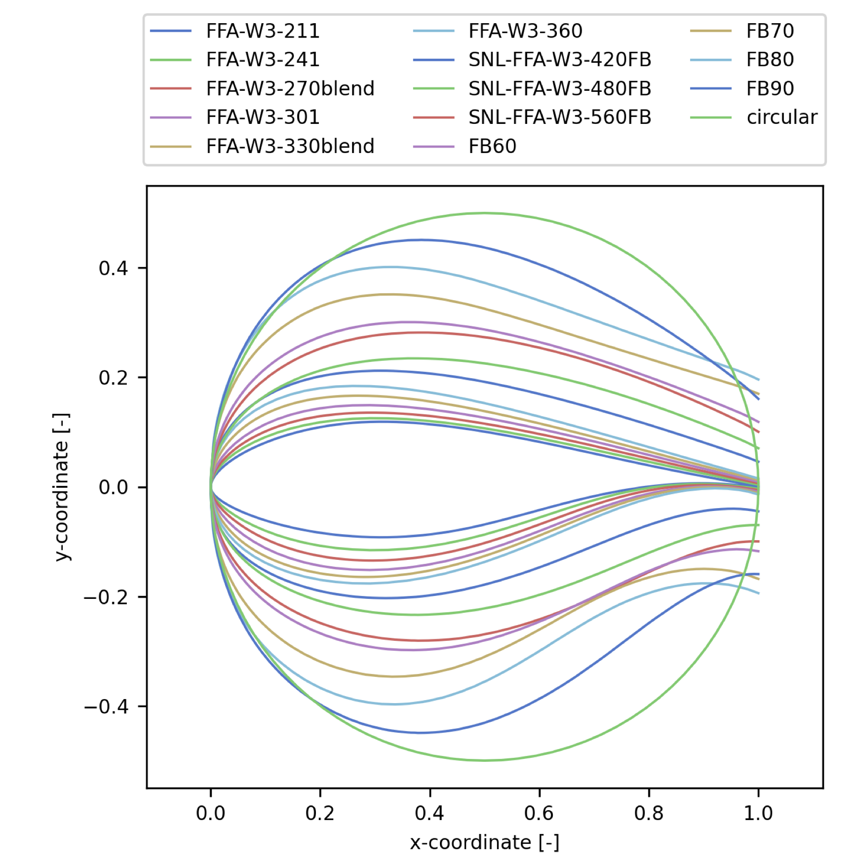
IEA 22MW Reference Turbine uses the FFA Airfoils
Outer Mold Line
Internal Structure
Zahle et. al., Definition of the IEA Wind 22-Megawatt Offshore Reference Wind Turbine, 2024

Slide 8
We need new airfoil options that are:
Open Source
Designed for modern applications
A reflection the state of airfoil design post 1990

Slide 9
Today we are presenting preliminary results
We want input from the community!

Slide 10
Design Approach

Slide 11
Meetings with advisory committee yielded design requirements
Normalized Thickness | 21% | 24% | 27% | 30%
Design Lift Coefficient | 1.5 | 1.4 | 1.3 | 1.2
Angle of Attack | N/A | N/A | N/A | N/A
Reynolds Number | 12e6 | 13e6 | 16e6 | 18e6
Clean L/D | 200 | 190 | 185 | 180
Rough L/D | 110 | 110 | 105 | 100
Stall Margin | 4 deg | 4 deg | 4 deg | 4 deg
Pre-Stall Lift Coefficient Margin | 0.2 | 0.2 | 0.2 | 0.2
Change in C_{L} due to Roughness | 0.15 | 0.14 | 0.13 | 0.12
C_{M} Clean | N/A | N/A | N/A | N/A
C_{M} Rough | N/A | N/A | N/A | N/A
LE Radius | 0.01 | 0.025 | 0.03 | 0.04
Flap Stiffness (I_{xx}) | 0.00028 | 0.00041 | 0.00058 | 0.00080
Edge Stiffness (I_{yy}) | 0.00494 | 0.00561 | 0.00633 | 0.00706
Torsion Stiffness (I_{zz}) | 0.00522 | 0.00602 | 0.00691 | 0.00786
Area | 0.11478 | 0.13051 | 0.14661 | 0.16290

Slide 12
Specifically seeking guidance on Lift Coefficient…
Normalized Thickness | 21% | 24% | 27% | 30%
Design Lift Coefficient | 1.5 | 1.4 | 1.3 | 1.2
Angle of Attack | N/A | N/A | N/A | N/A
Reynolds Number | 12e6 | 13e6 | 16e6 | 18e6
Clean L/D | 200 | 190 | 185 | 180
Rough L/D | 110 | 110 | 105 | 100
Stall Margin | 4 deg | 4 deg | 4 deg | 4 deg
Pre-Stall Lift Coefficient Margin | 0.2 | 0.2 | 0.2 | 0.2
Change in C_{L} due to Roughness | 0.15 | 0.14 | 0.13 | 0.12
C_{M} Clean | N/A | N/A | N/A | N/A
C_{M} Rough | N/A | N/A | N/A | N/A
LE Radius | 0.01 | 0.025 | 0.03 | 0.04
Flap Stiffness (I_{xx}) | 0.00028 | 0.00041 | 0.00058 | 0.00080
Edge Stiffness (I_{yy}) | 0.00494 | 0.00561 | 0.00633 | 0.00706
Torsion Stiffness (I_{zz}) | 0.00522 | 0.00602 | 0.00691 | 0.00786
Area | 0.11478 | 0.13051 | 0.14661 | 0.16290

Slide 13
…along with Moment Coefficient
Normalized Thickness | 21% | 24% | 27% | 30%
Design Lift Coefficient | 1.5 | 1.4 | 1.3 | 1.2
Angle of Attack | N/A | N/A | N/A | N/A
Reynolds Number | 12e6 | 13e6 | 16e6 | 18e6
Clean L/D | 200 | 190 | 185 | 180
Rough L/D | 110 | 110 | 105 | 100
Stall Margin | 4 deg | 4 deg | 4 deg | 4 deg
Pre-Stall Lift Coefficient Margin | 0.2 | 0.2 | 0.2 | 0.2
Change in C_{L} due to Roughness | 0.15 | 0.14 | 0.13 | 0.12
C_{M} Clean | N/A | N/A | N/A | N/A
C_{M} Rough | N/A | N/A | N/A | N/A
LE Radius | 0.01 | 0.025 | 0.03 | 0.04
Flap Stiffness (I_{xx}) | 0.00028 | 0.00041 | 0.00058 | 0.00080
Edge Stiffness (I_{yy}) | 0.00494 | 0.00561 | 0.00633 | 0.00706
Torsion Stiffness (I_{zz}) | 0.00522 | 0.00602 | 0.00691 | 0.00786
Area | 0.11478 | 0.13051 | 0.14661 | 0.16290

Slide 14
Design process uses XFOIL with RFOIL for validation
Write Objective Function using XFOIL
Run Genetic Algorithm on Sandia HPC
Select High Performing Candidates from
GA Results
Modify Airfoils to Match Design Intent
(As Needed)
Validate XFOIL Data with RFOIL for Final Designs
Report Final Performance Metrics

Slide 15
Does XFOIL capture the design space to the extent we need?
Write Objective Function using XFOIL
Run Genetic Algorithm on Sandia HPC
Select High Performing Candidates from
GA Results
Modify Airfoils to Match Design Intent
(As Needed)
Validate XFOIL Data with RFOIL for Final Designs
Report Final Performance Metrics

Slide 16
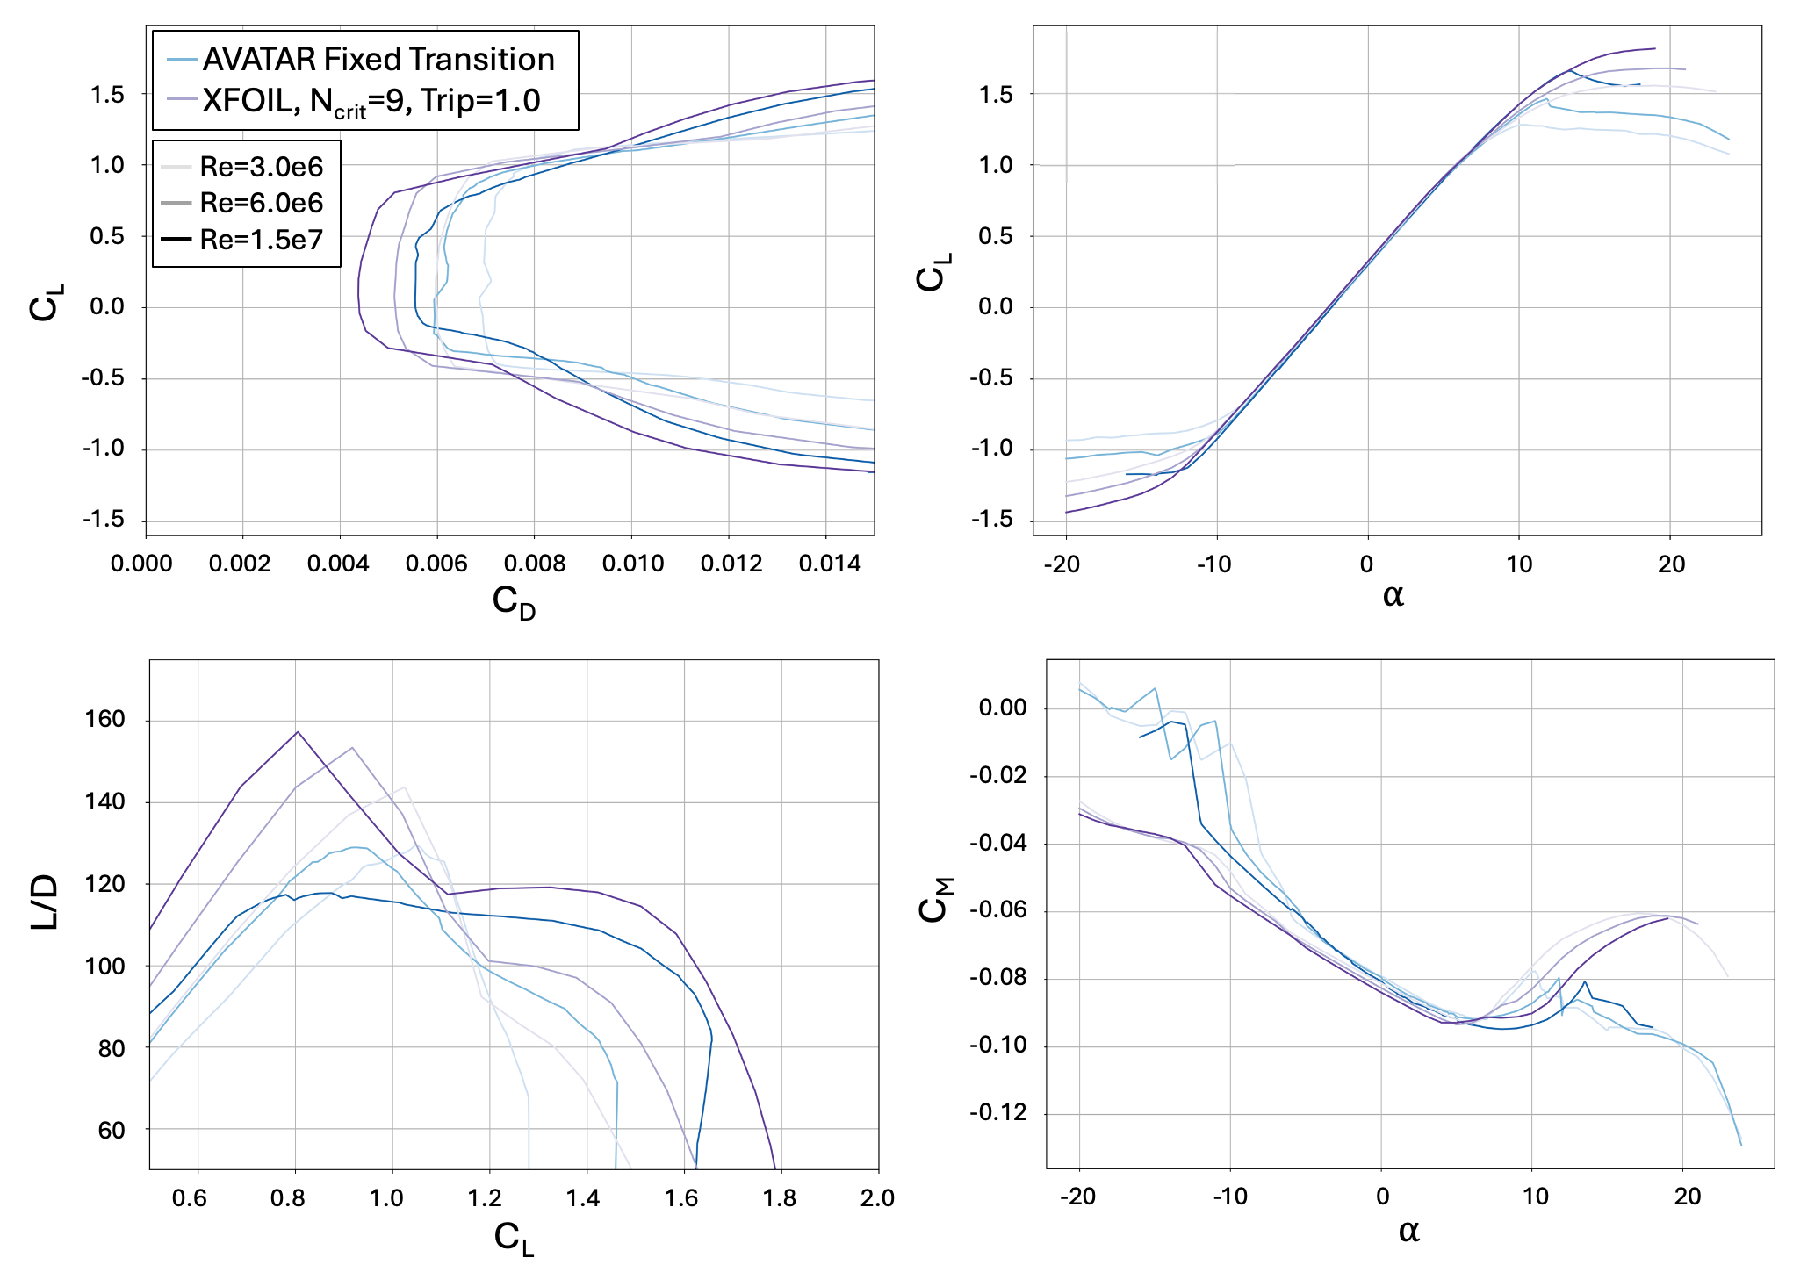
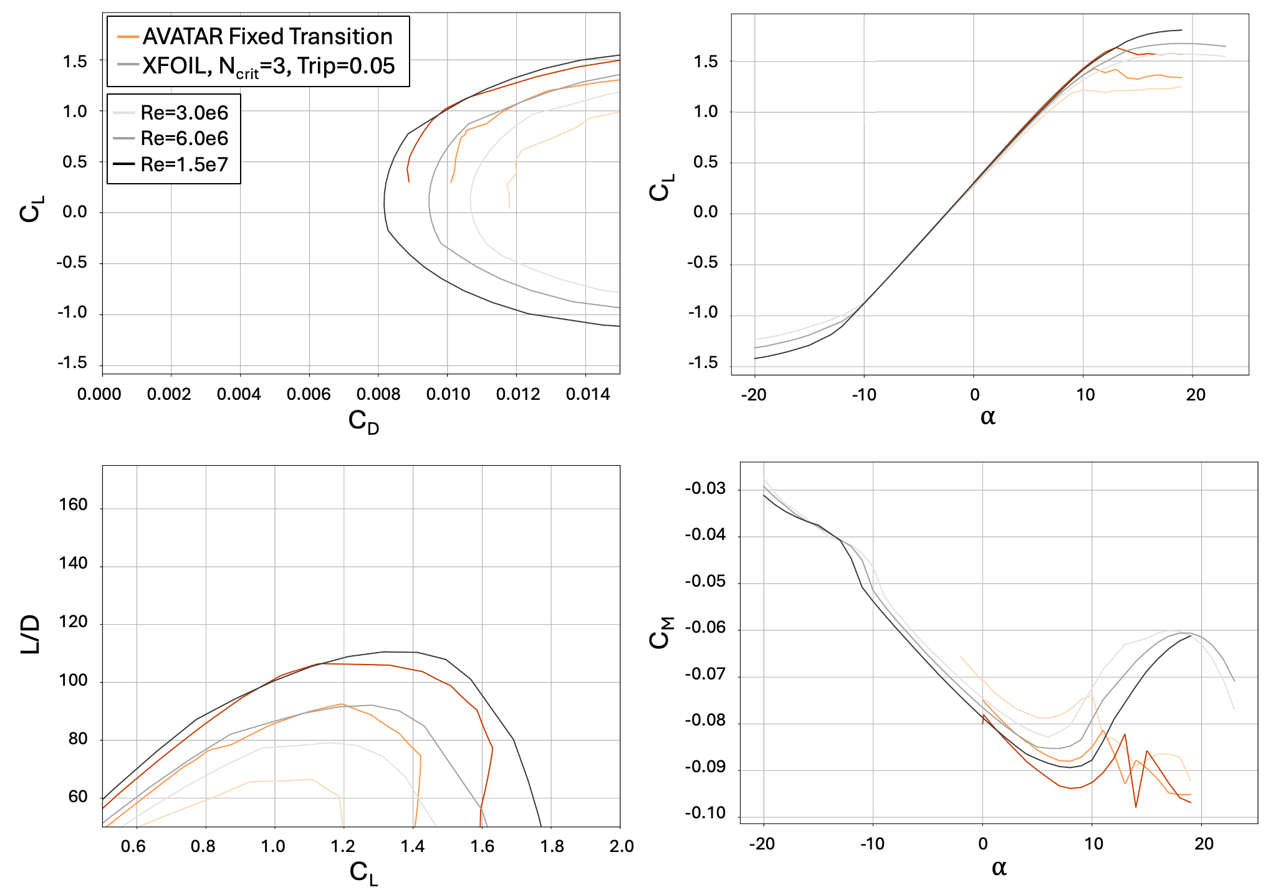
XFOIL untrustworthy in an absolute sense, but is OK for design
Free
Pires et. al., Analysis of High Reynolds Numbers Effects on a Wind Turbine Airfoil Using 2D Wind Tunnel Test Data, 2016

Slide 17
How does the Genetic Algorithm Perform?
Write Objective Function using XFOIL
Run Genetic Algorithm on Sandia HPC
Select High Performing Candidates from
GA Results
Modify Airfoils to Match Design Intent
(As Needed)
Validate XFOIL Data with RFOIL for Final Designs
Report Final Performance Metrics

Slide 18
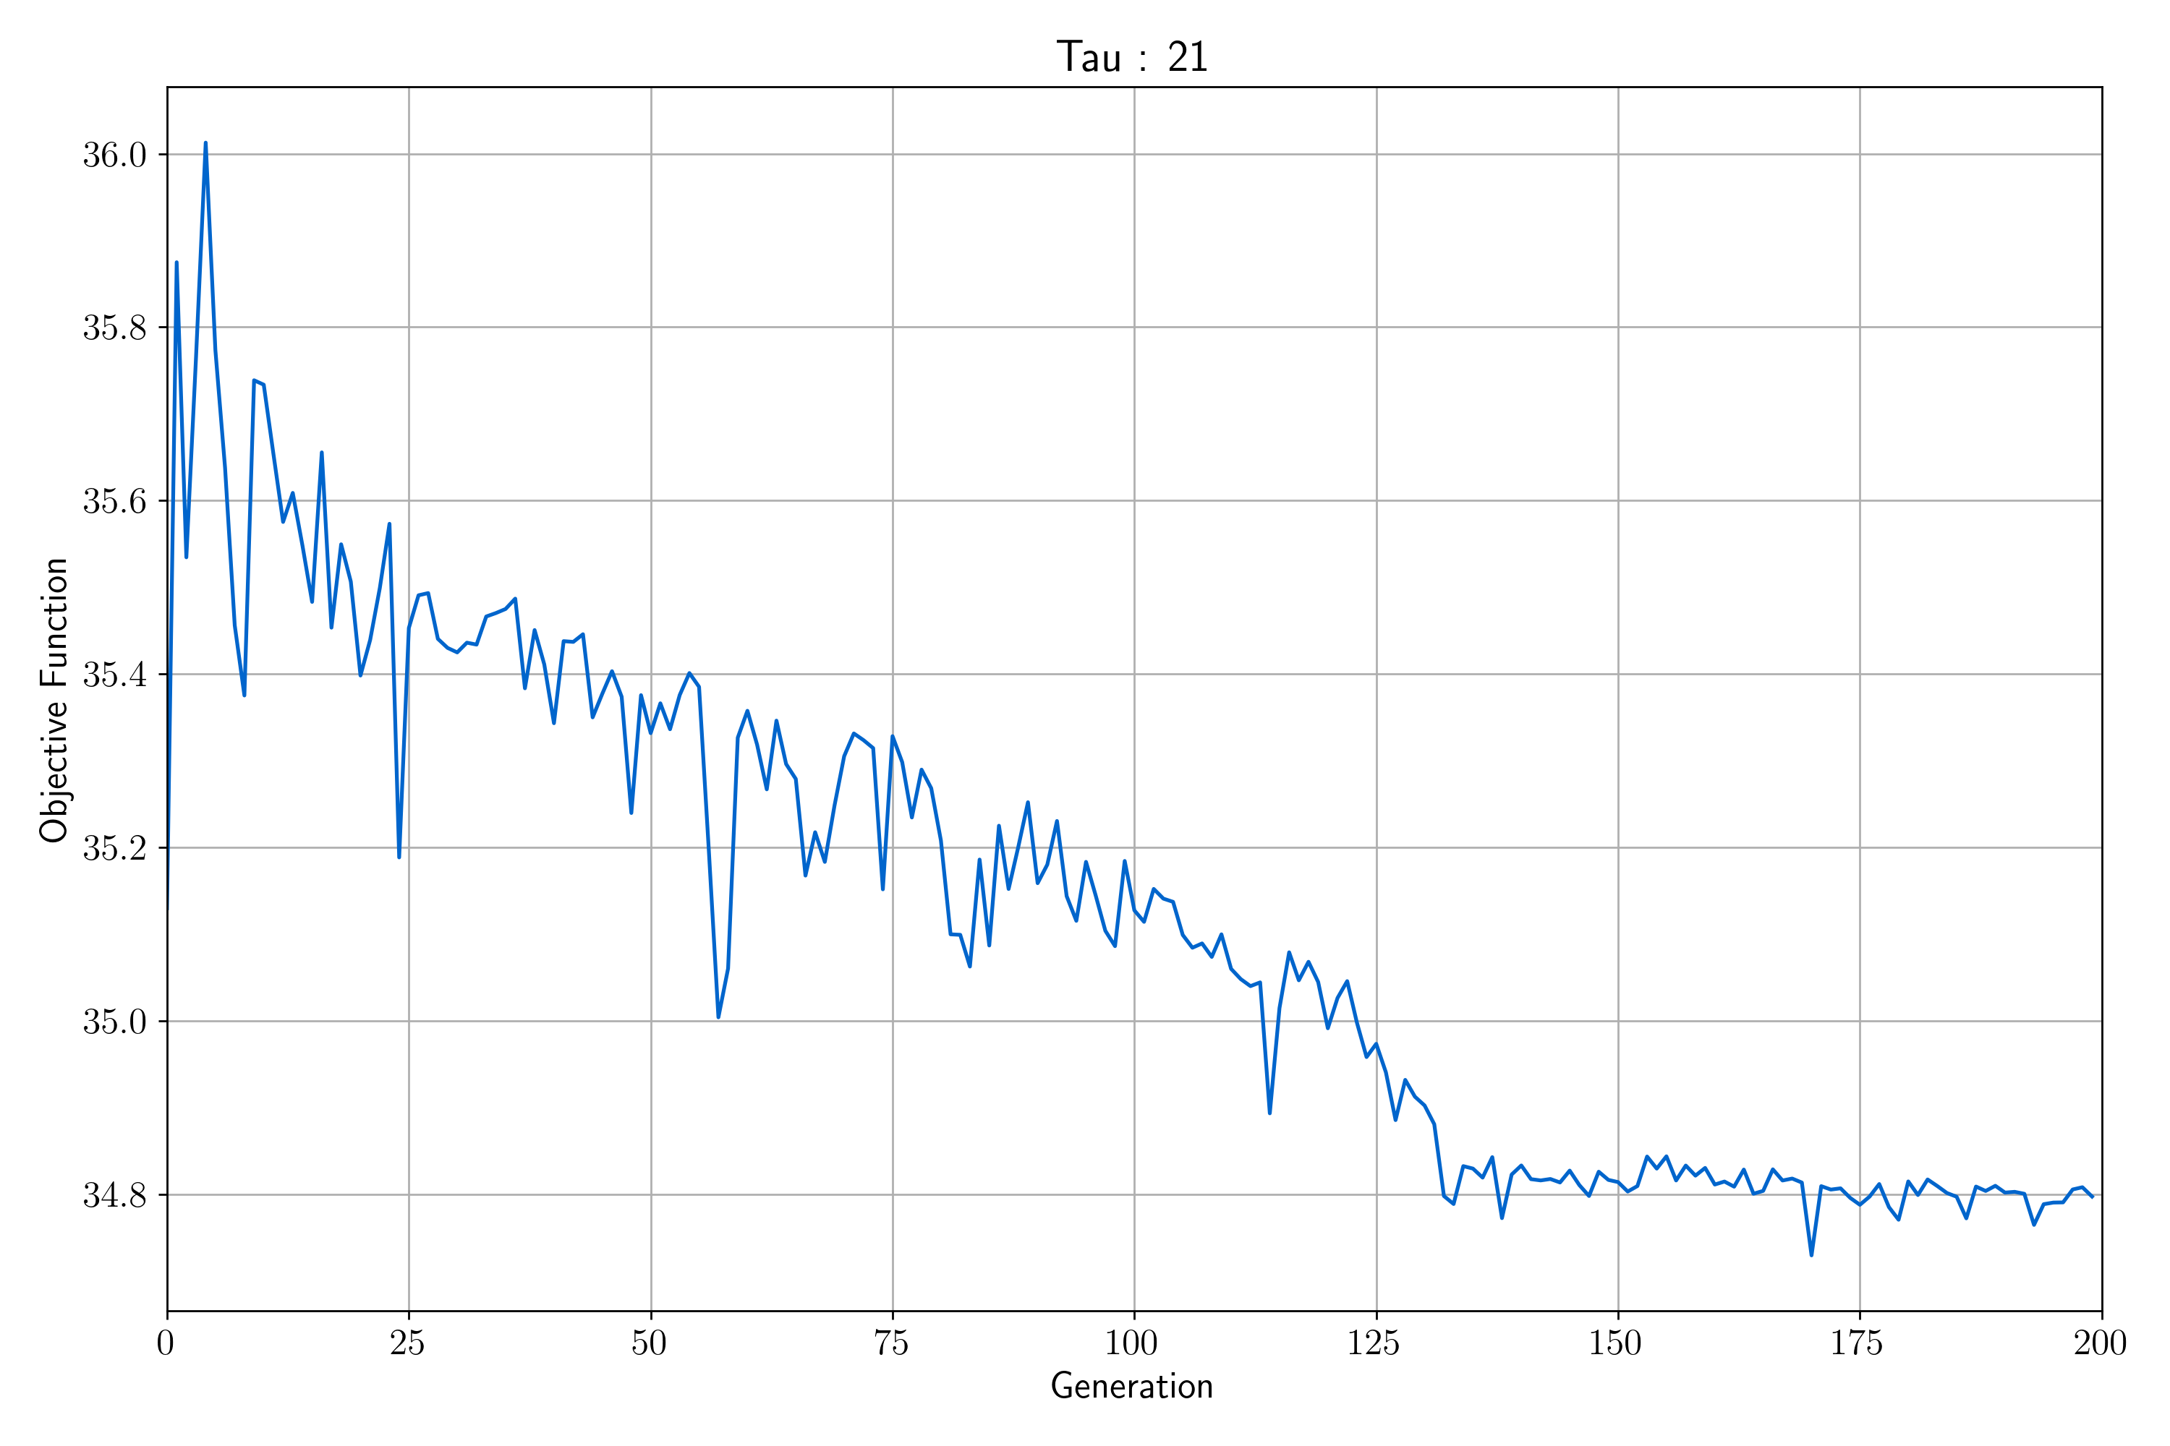
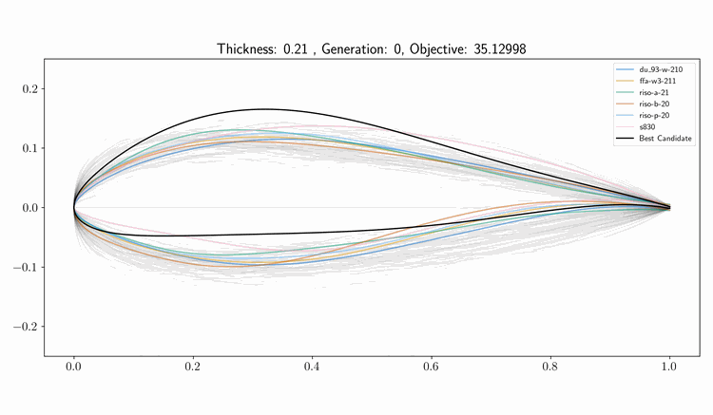
Genetic Algorithm successfully identifies promising designs

Slide 19
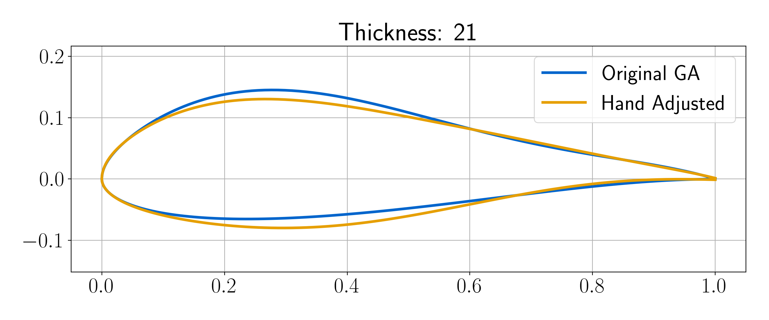
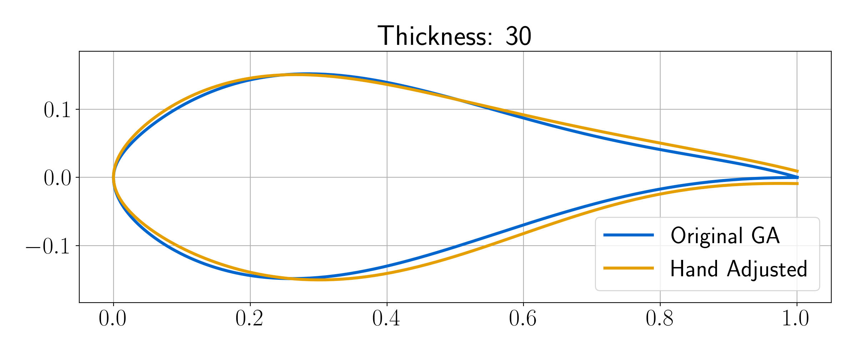
Hand adjustments are made as needed to improve designs

Slide 20
Airfoils and Performance Results

Slide 21
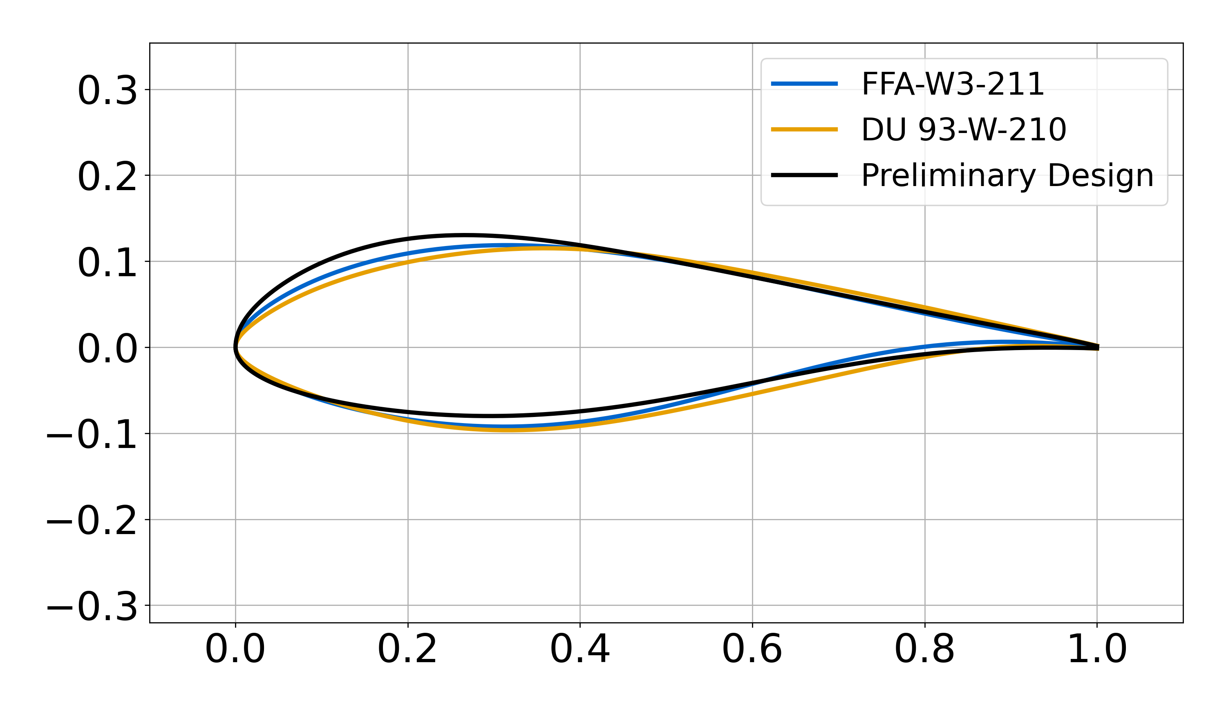
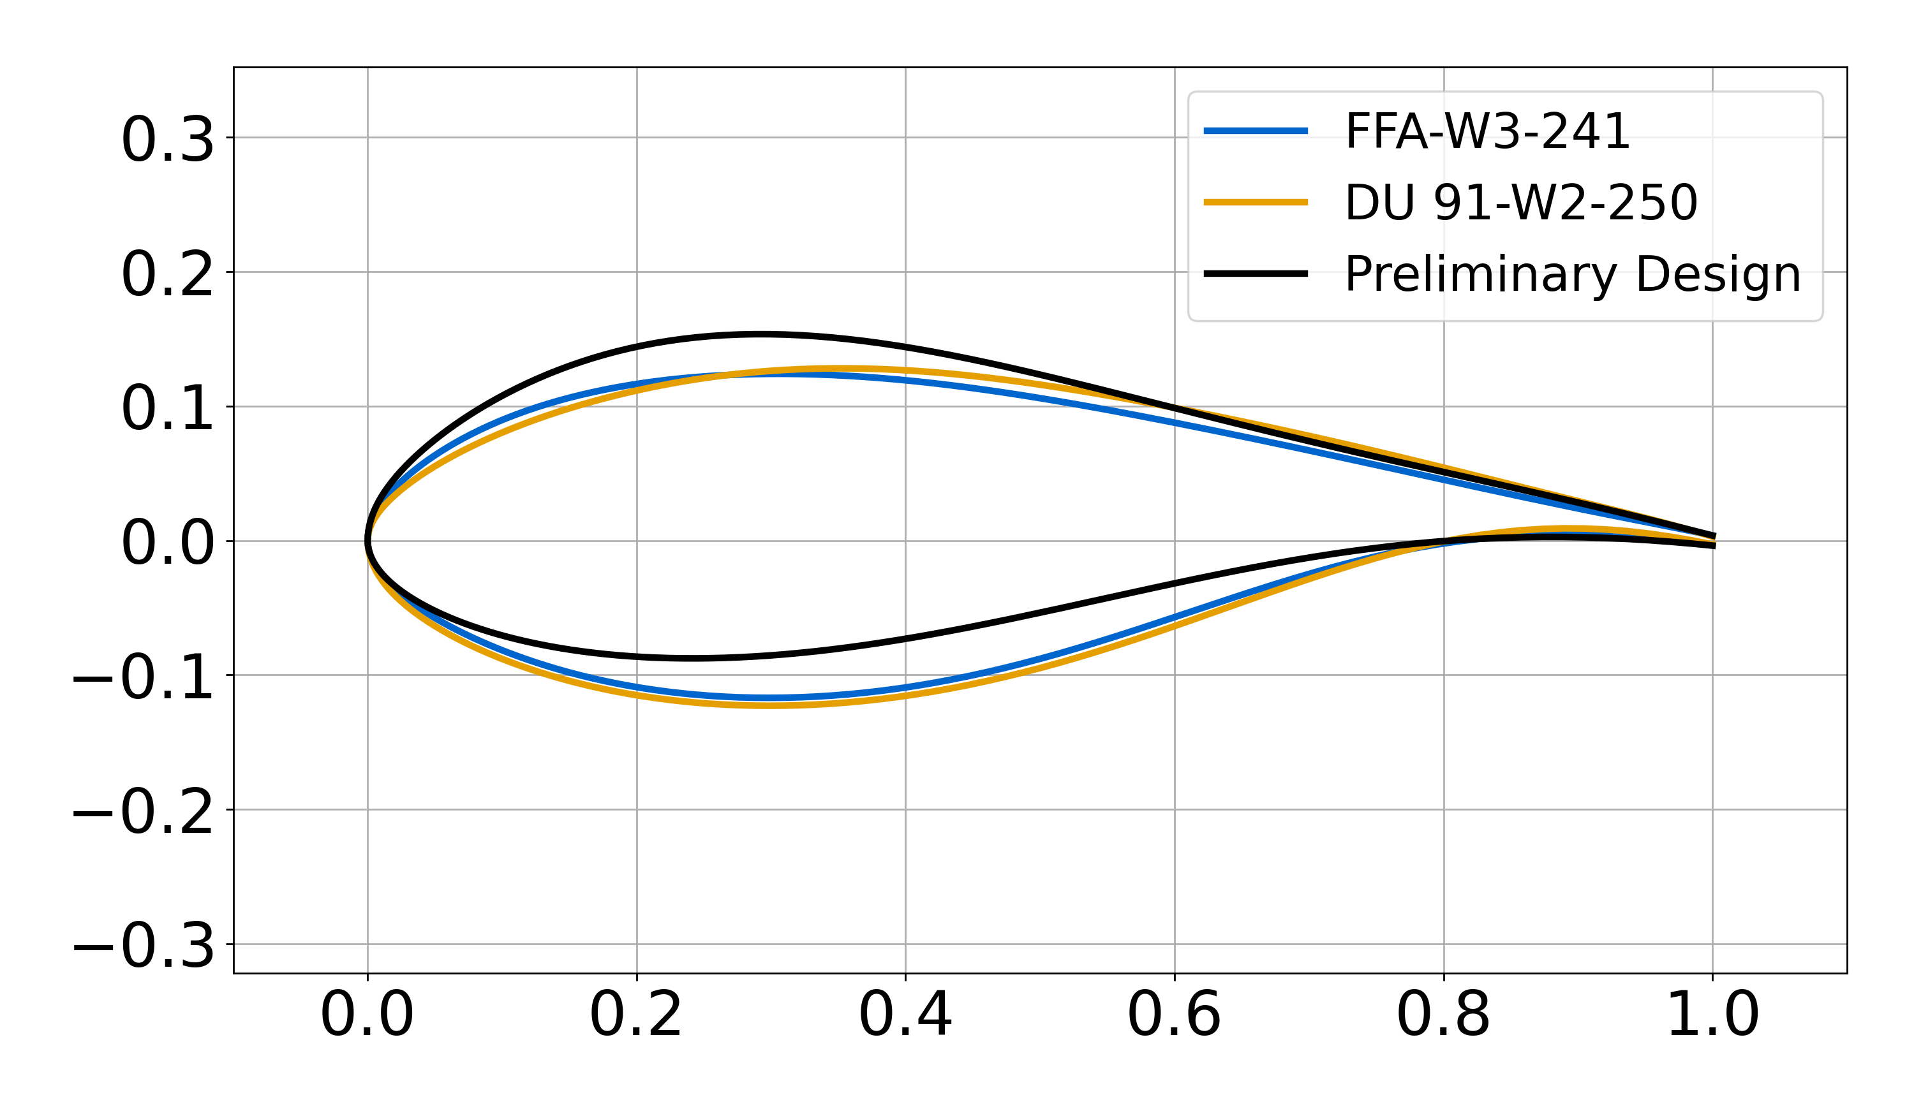
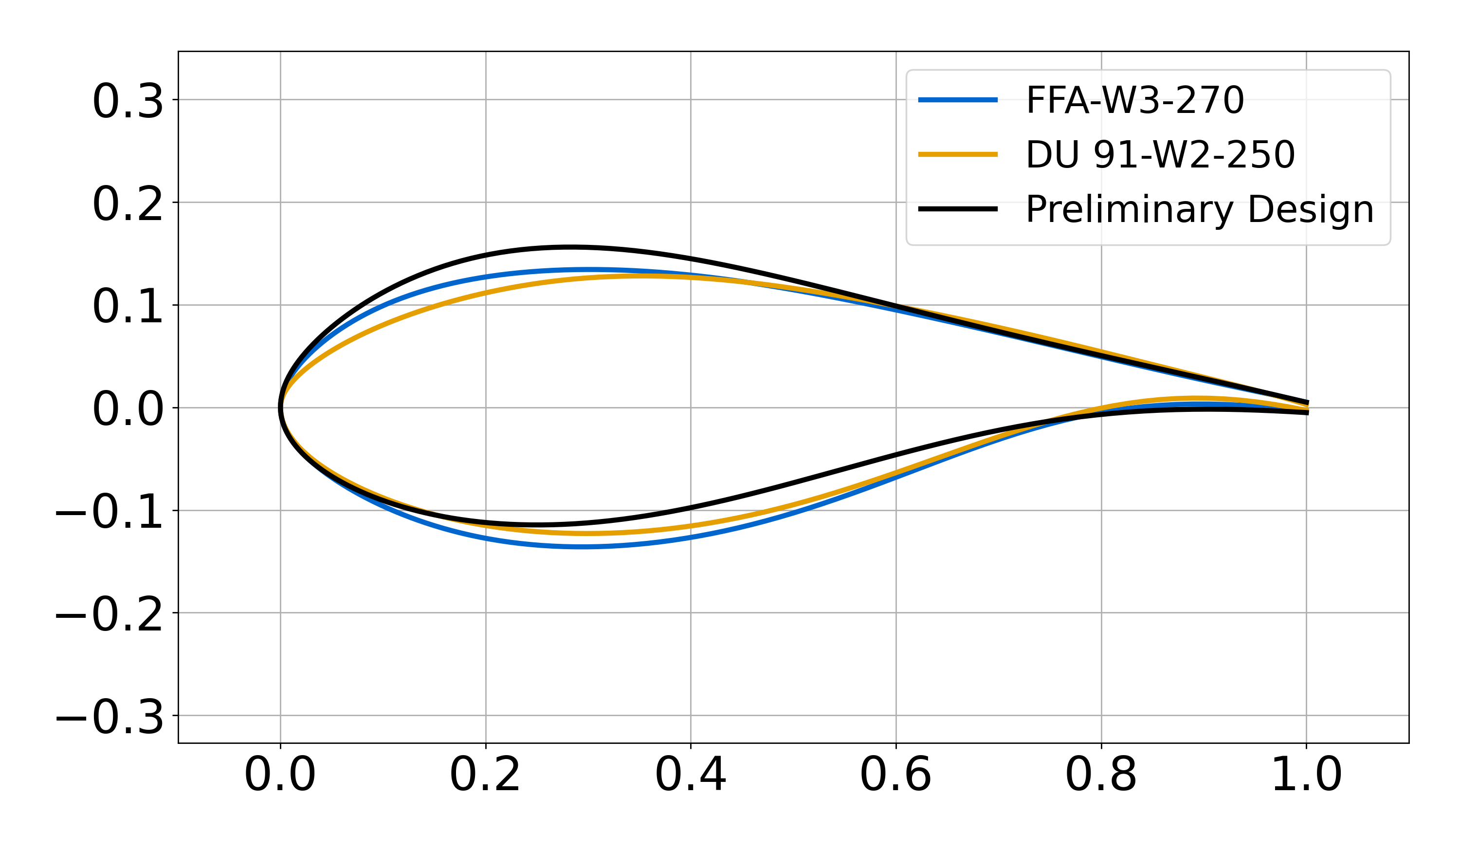
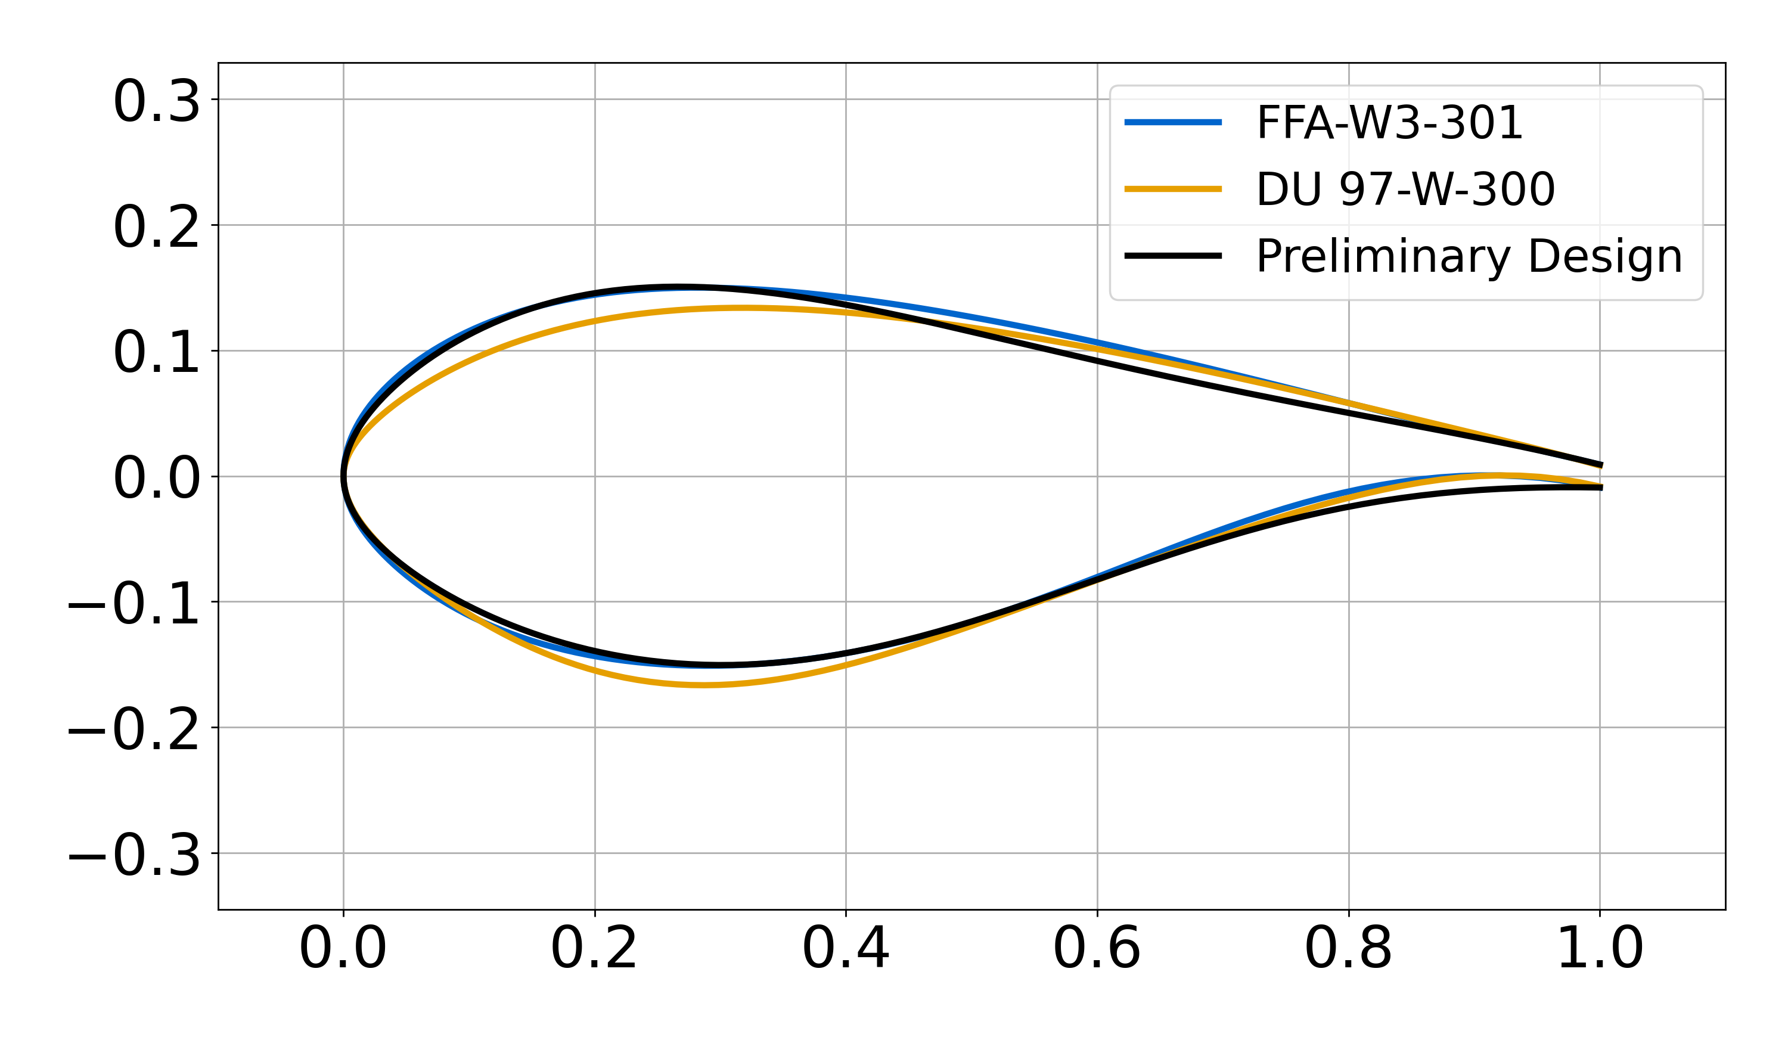
The Preliminary Airfoil Family
21%
24%
27%
30%

Slide 22
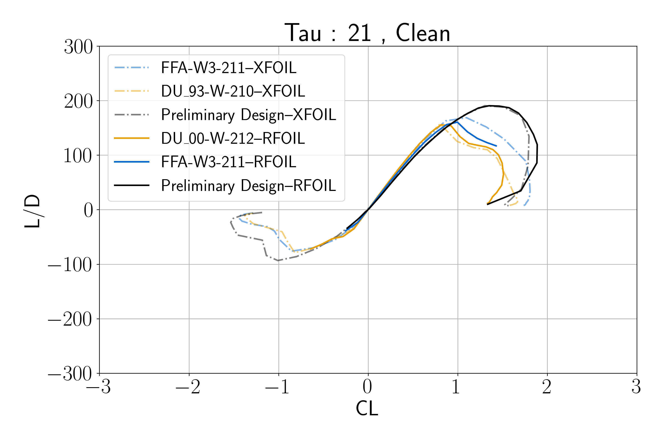
21% Airfoil

Slide 23
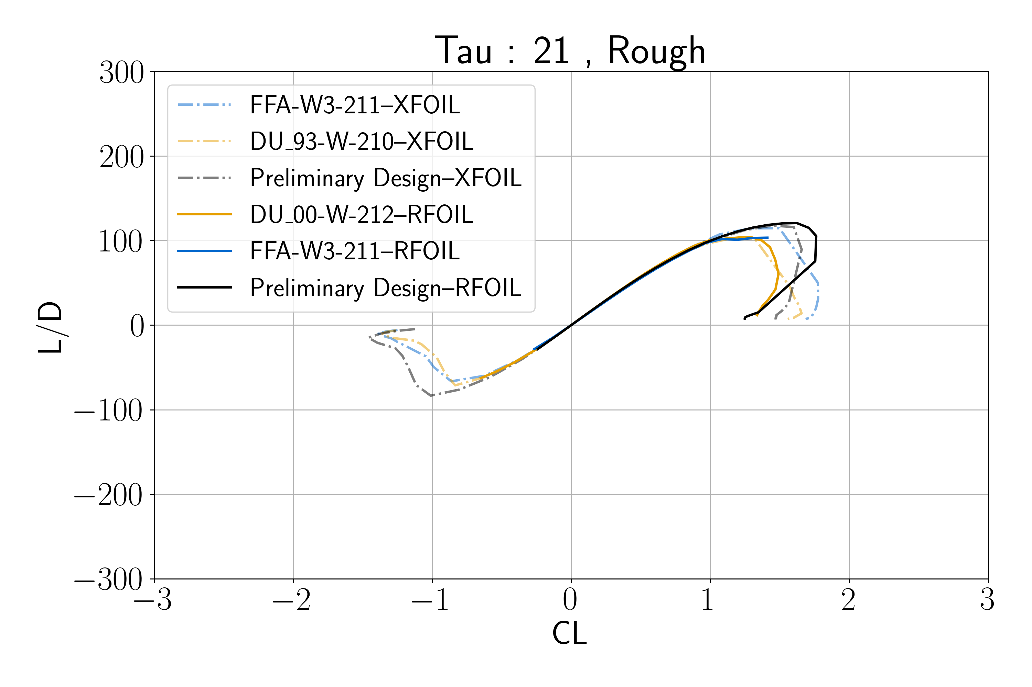
21% Airfoil

Slide 24
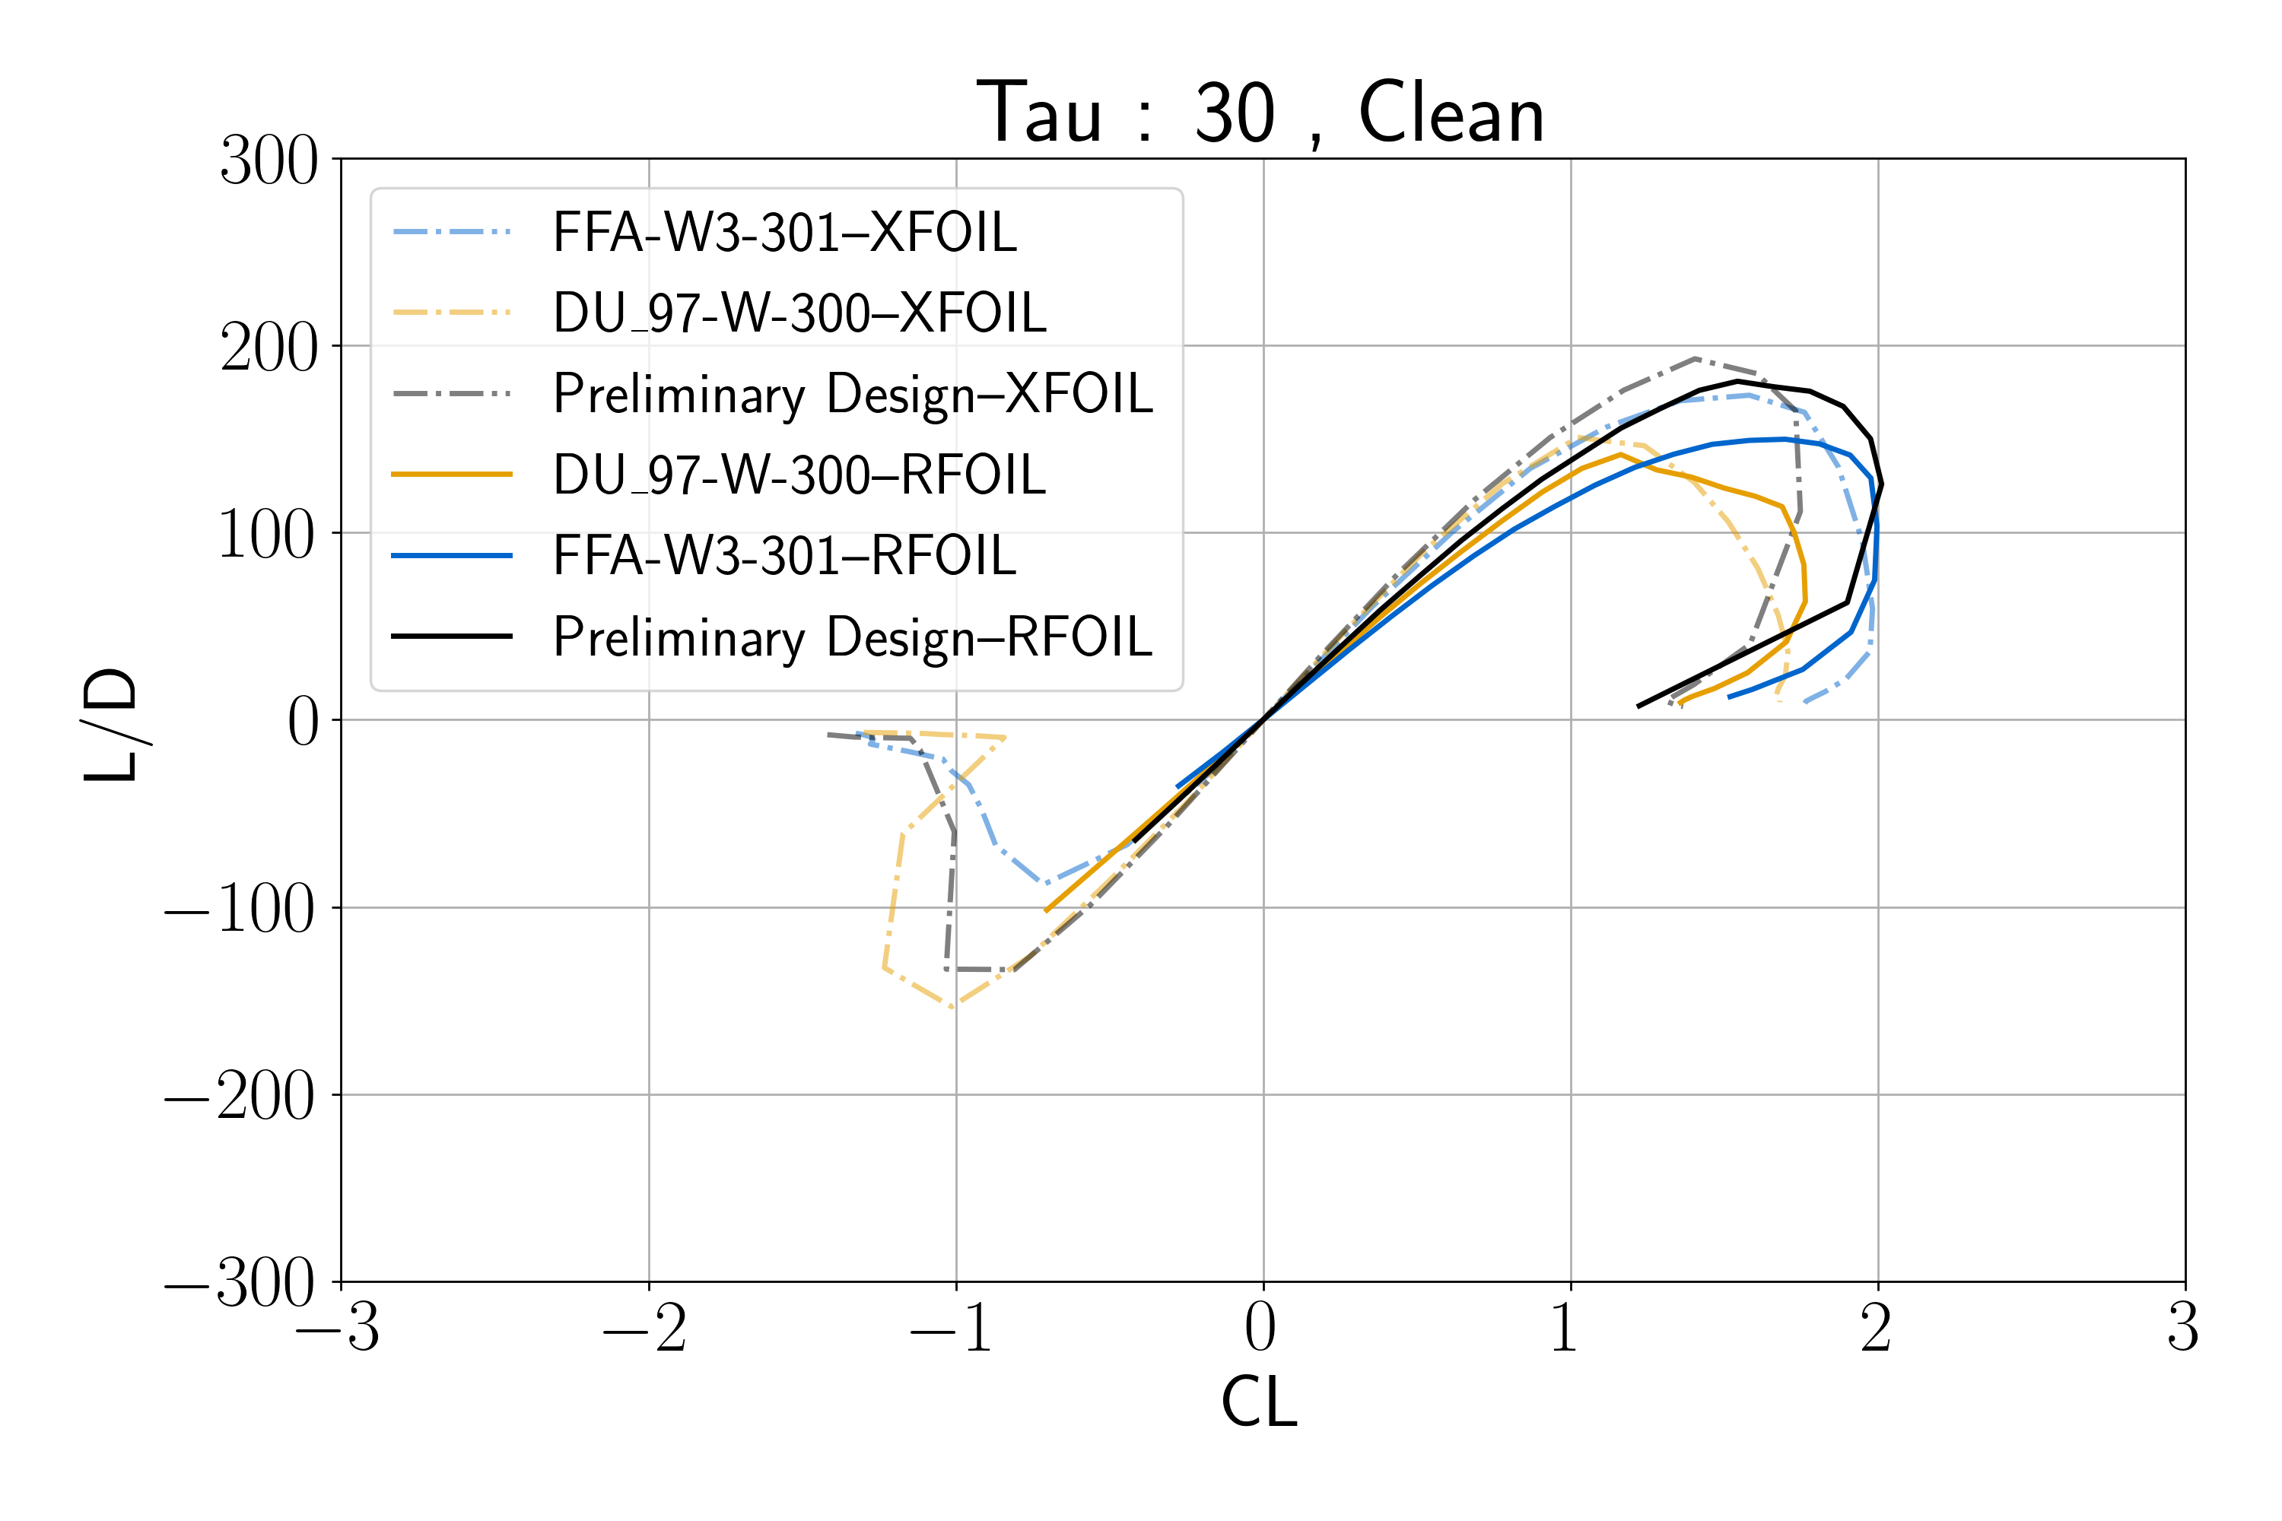
30% Airfoil

Slide 25
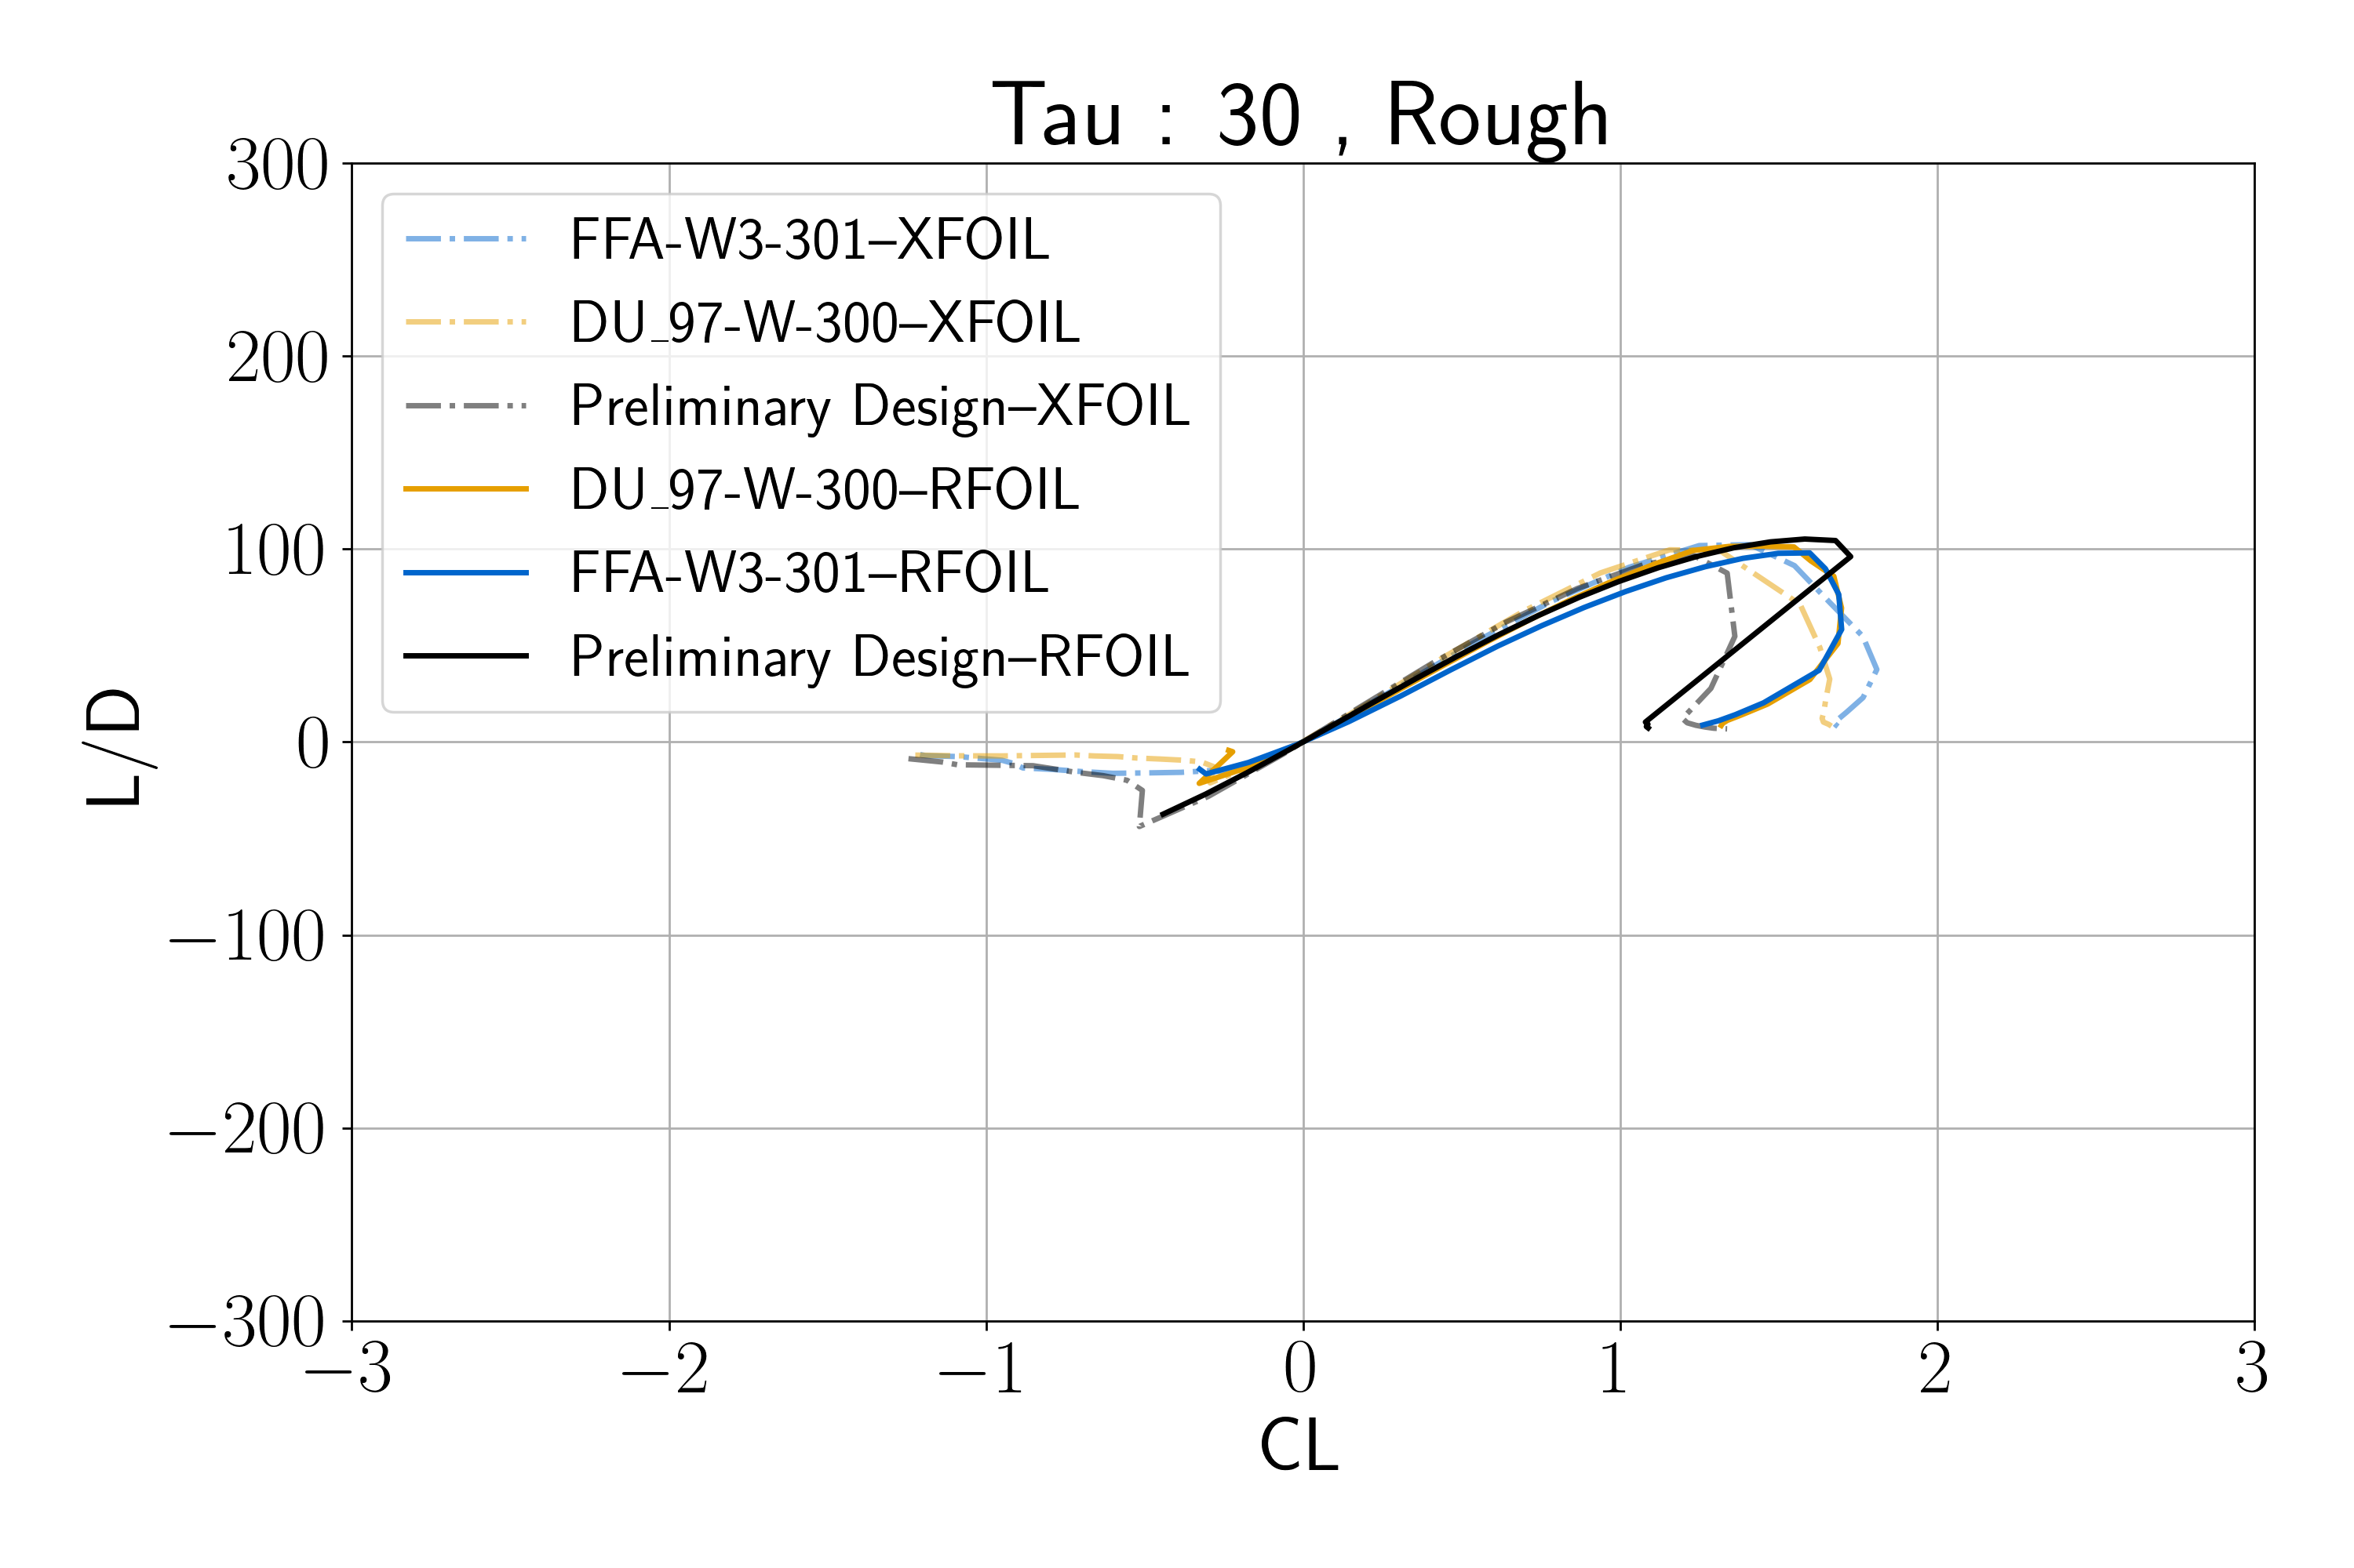
30% Airfoil

Slide 26
Hand Modified airfoils perform well in design metrics (RFOIL)
Normalized Thickness | 21% | 24% | 27% | 30%
Design Lift Coefficient | 1.5 | 1.4 | 1.3 | 1.2
Reynolds Number | 12e6 | 13e6 | 16e6 | 18e6
Angle of Attack | 9.67 | 6.39 | 6.43 | 7.72
Clean L/D | 183.36 | 202.80 | 184.58 | 156.10
Rough L/D | 124.14 | 106.43 | 109.60 | 95.42
Stall Margin (degrees) | 3.80 | 4.09 | 5.98 | 5.66
Pre-Stall Lift Coefficient Margin | 0.39 | 0.62 | 0.75 | 0.81
Change in C_{L} due to Roughness | 0.01 | 0.08 | 0.06 | 0.01
C_{M} Clean | -0.081 | -0.131 | -0.118 | -0.087
C_{M} Rough | -0.073 | -0.123 | -0.110 | -0.078
LE Radius | 0.02216 | 0.02881 | 0.04809 | 0.05086
Flap Stiffness (I_{xx}) | 0.00030 | 0.00043 | 0.00060 | 0.00085
Edge Stiffness (I_{yy}) | 0.00578 | 0.00637 | 0.00721 | 0.00867
Torsion Stiffness (I_{zz}) | 0.00608 | 0.00680 | 0.00782 | 0.00952
Area | 0.12399 | 0.13782 | 0.15487 | 0.17749

Slide 27
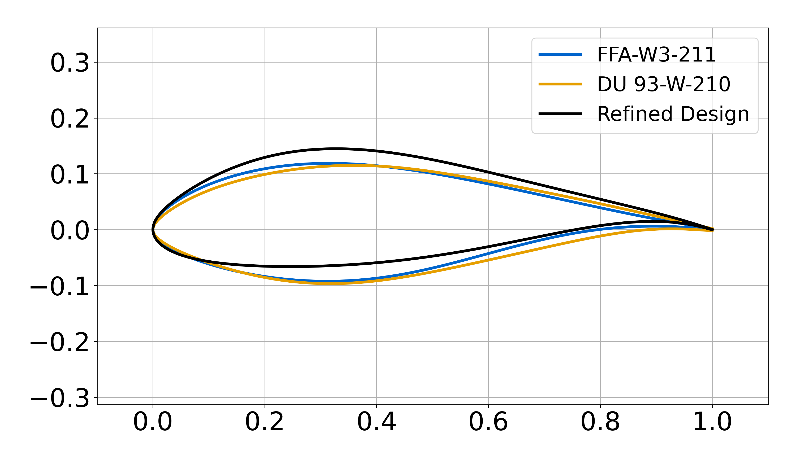
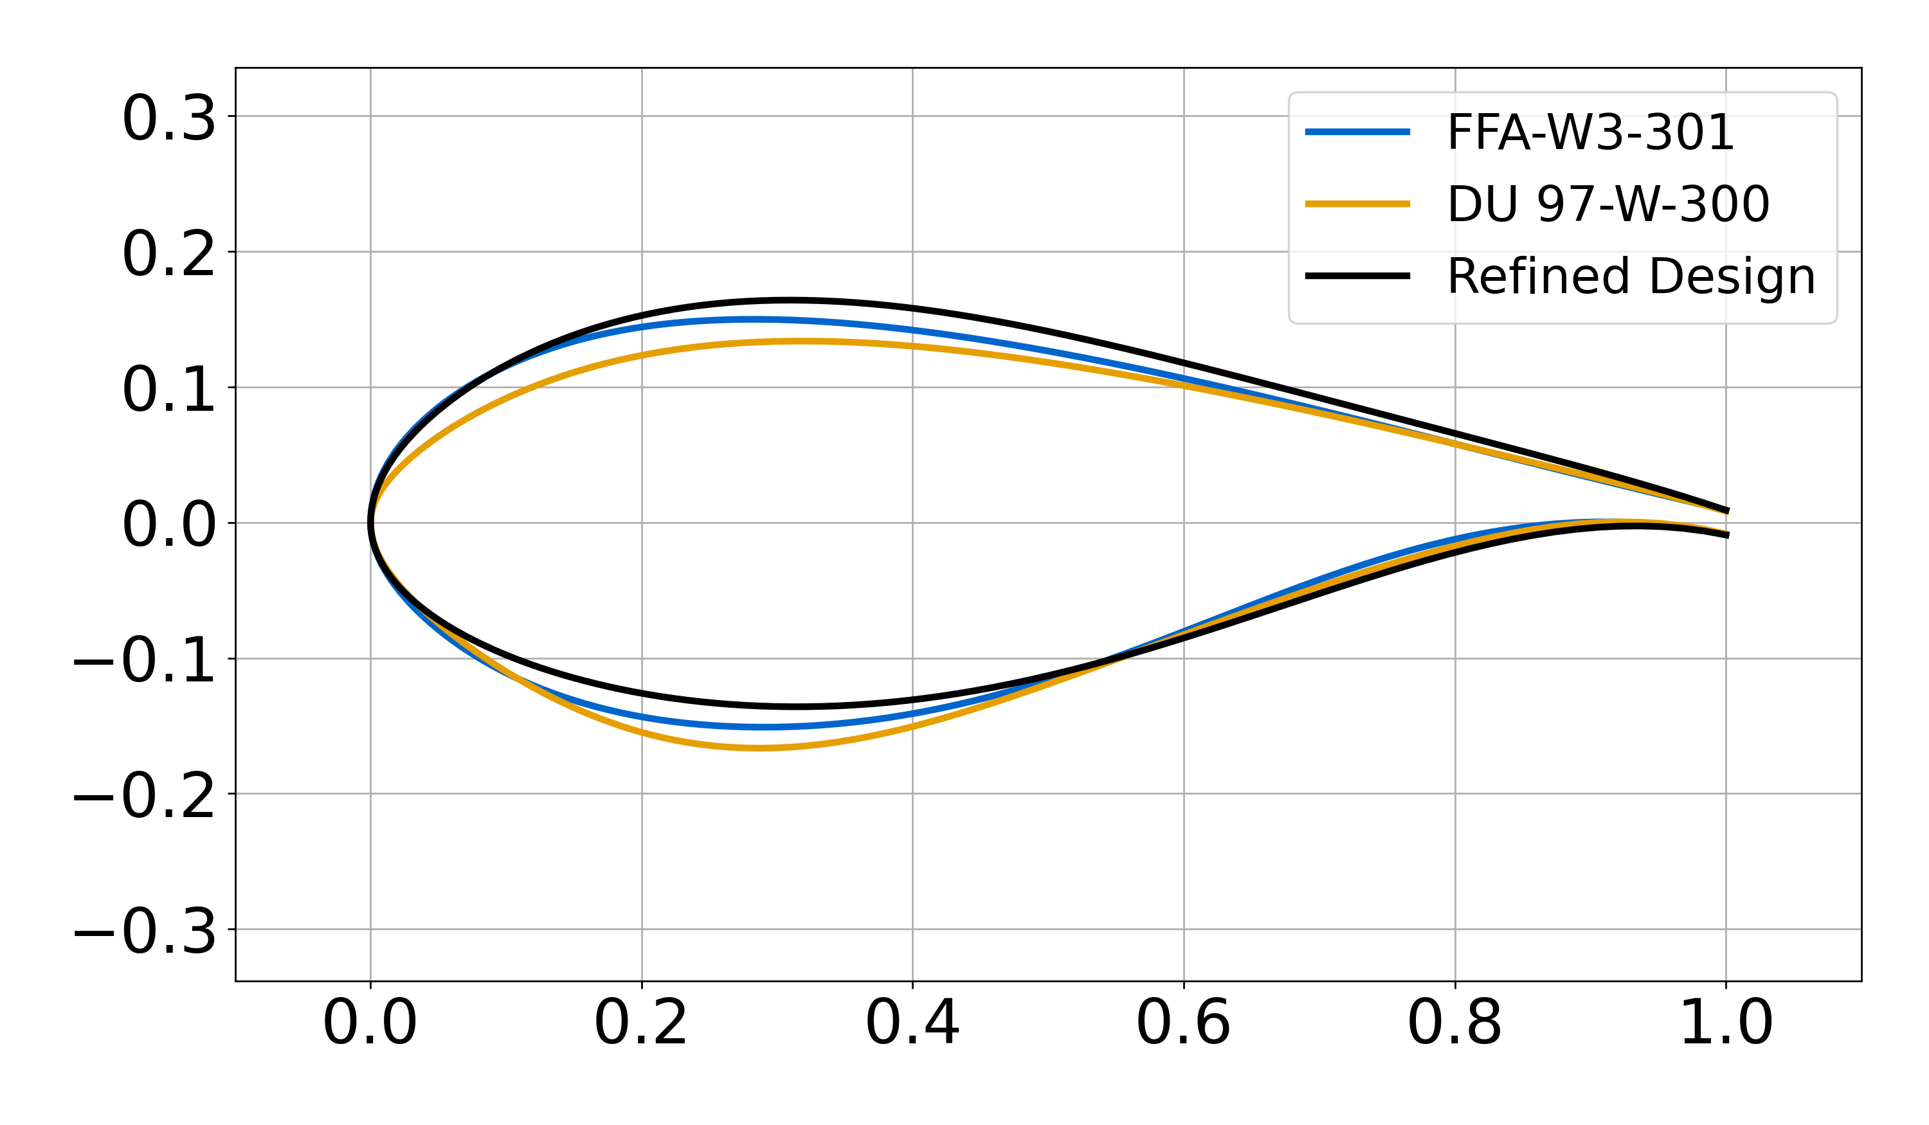
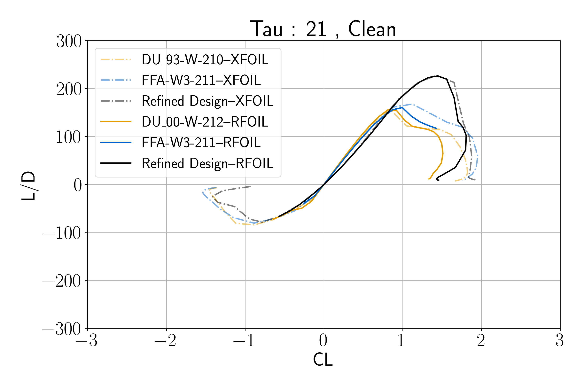
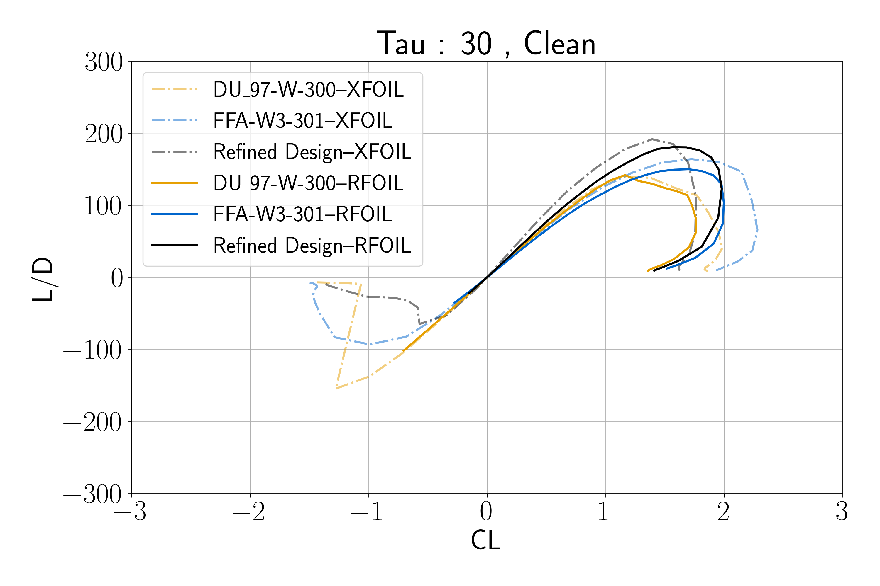
Recent Refinements

Slide 28
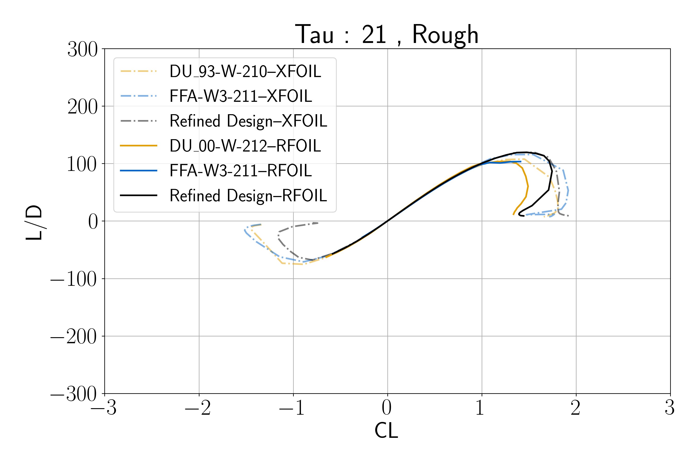
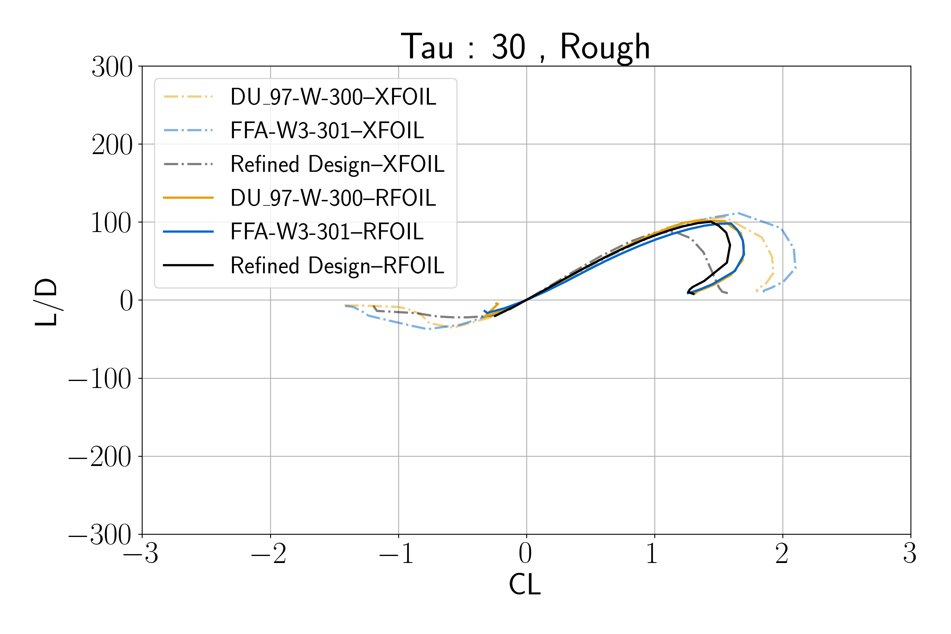
Recent Refinements

Slide 29
Next Steps

Slide 30
Future tasks are refinement and application
Continue to refine the requirements, objective function
Consider family together as a whole and spar layout
Consider 3D aero effects
Model full rotor performance
Incorporate community feedback
Final versions of these airfoils are being considered as candidates for experimental testing

Slide 31
Questions?
Please send us your comments at:
Cody Karcher
cody.karcher@csulb.edu
David Maniaci
dcmania@sandia.gov

Slide 32
Backup

Slide 33
Design Lift Coefficient
Design Choice
Initially selected to be C_{L}=1.2 for the entire family
Later selected C_{L}=1.5 at tip reducing to C_{L}=1.2 at ~40% span to follow IEA 22MW reference turbine design conditions
Should occur in the linear region of the CL-Alpha curve
C_{L}
C_{L}
1.2
⍺_{des}
⍺
C_{D}
Notes:
The design lift coefficient is a design choice, so we are looking for suggestions of the most appropriate range.

Slide 34
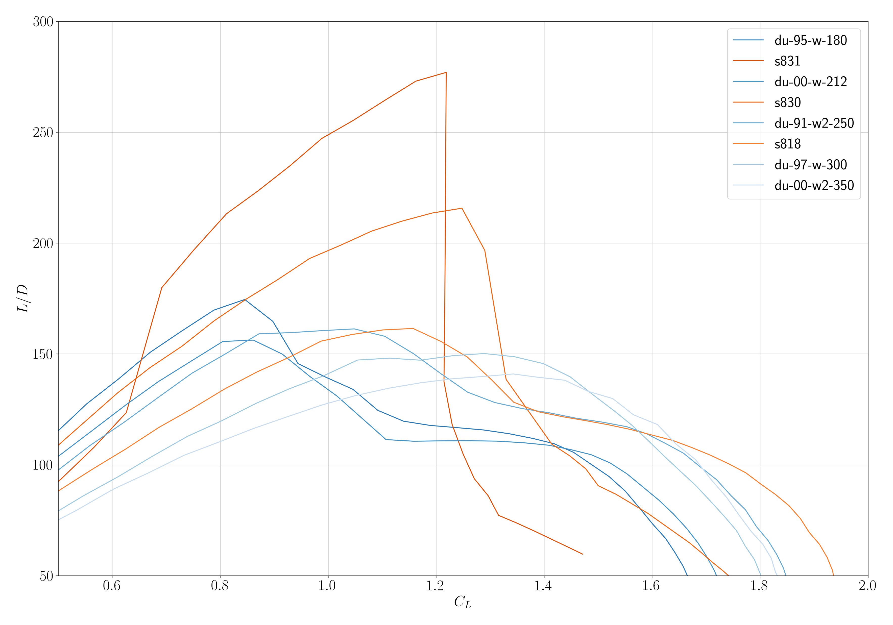
Lift to Drag Ratio (L/D)
Design Target
Should be maximized with a target of between 170 and 200
Desire a clear increase over DU/FFA/Riso series
Desire more robust performance than S-series (broader peak, less Re# dependance)
Normalized Thickness | 15% | 18% | 21% | 24% | 27% | 30% | 33% | 36%
L/D Target | 200 | 200 | 200 | 190 | 185 | 180 | 175 | 170
XFOIL Data at 3 Million Re

Slide 35
Stall Margin--Clean
Design Requirement
Angle of attack difference between design C_{L} and C_{L,max}
Must exceed 3 degrees for robustness to real-world conditions
C_{L}
C_{L}
Stall Margin
⍺_{des}
⍺_{stall}
⍺
C_{D}

Slide 36
Stall Margin--Rough
Design Requirement
Same as clean, but modeled using N_{crit} and transition location
Must exceed 3 degrees for robustness to real-world conditions
C_{L}
C_{L}
Rough Stall Margin
⍺_{des}
⍺_{stall,rough}
⍺
C_{D}

Slide 37
Lift Coefficient Margin to Stall
Design Target
Should be minimized to limit gust loading
Target a nominally small value of 0.2
C_{L}
C_{L}
C_{L,stall}
C_{L,des}
C_{L} Margin
⍺
C_{D}

Slide 38
Change in Lift Coefficient Due to Roughness
Design Requirement
Measured as change in C_{L} at the AoA of the clean design C_{L}
Limit to a change of less than 10% from clean baseline
C_{L}
C_{L}
ΔC_{L}
⍺_{des}
⍺
C_{D}
Notes:
Is 10% drop in lift too high at the AoA for design Cl?

Slide 39
L/D Ratio in the Operating Region--Smooth
Design Target
L/D curve should be reasonably flat in the desired operating region
Target within 15% of (L/D)_{des} within +/-15% of ⍺_{des}
ΔL/D
ΔL/D
C_{L} / C_{D}
C_{L}
0.85 ⍺_{des}
⍺_{des}
1.15 ⍺_{des}

Slide 40
L/D Ratio in the Operating Region--Rough
Design Target
Same as before, but for rough airfoil
Target within 5% of (L/D)_{des} within +/-15% of ⍺_{des}
ΔL/D
ΔL/D
C_{L} / C_{D}
C_{L}
0.85 ⍺_{des}
⍺_{des}
1.15 ⍺_{des}

Slide 41
Post-Stall Behavior
Human Selection
Post-stall slope is a major factor in blade fatigue
Should be minimized, but will only be used as a final selection criteria
C_{L}
dC_{L} /d⍺
C_{L}
3 deg
⍺_{stall}
⍺
C_{D}
(dC_{L} /d⍺)_{neg}
Notes:
Proposal is to compute this slope over say 3 degrees rather than capturing the actual local slope.

Slide 42
Structural Performance

Slide 43
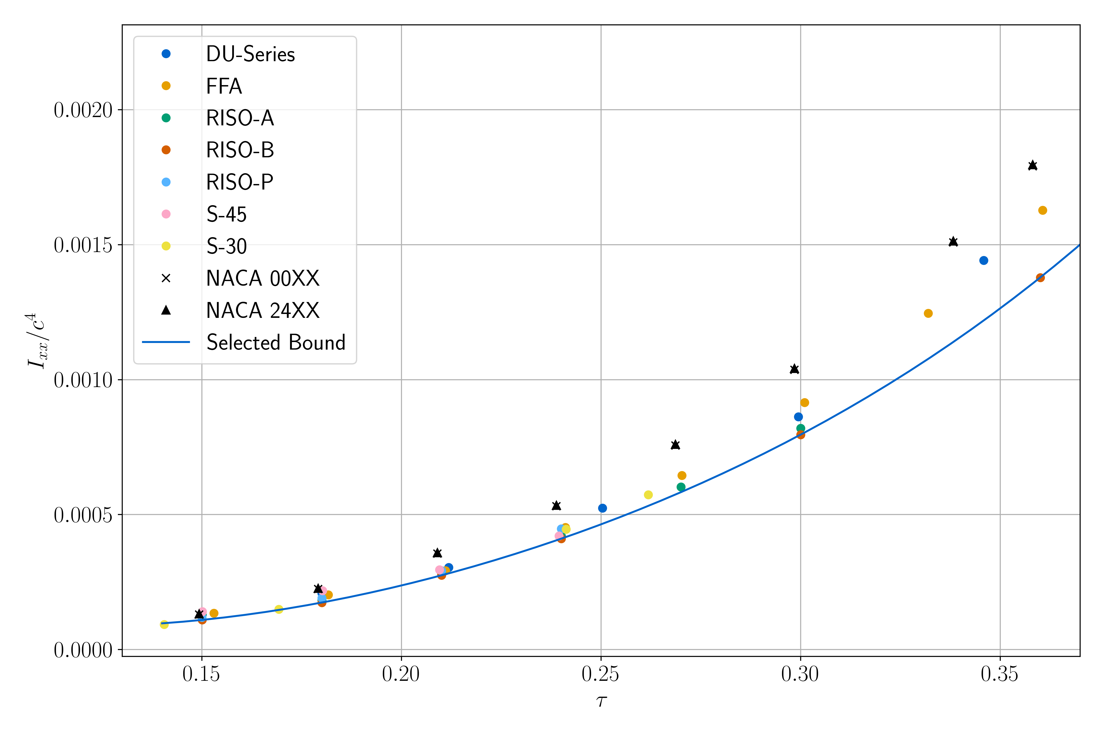
Solid Body Geometry Properties
Design Requirement
Performed a study of solid area geometry properties of existing airfoils
I_{xx} (Bending), I_{yy} (Edgewise), I_{zz} (Torsion), and Area
Strong correlation and separation from non-turbine airfoils
Will implement lower bound of existing airfoils as a design constraint
Require Ixx to be higher than bound
Notes:
We plan to set a constraint to have structural performance no worse than any current wind turbine airfoil families.
Can consider including tradeoffs in improving aero. vs. structure performance in later iterations, likely future work.
ARE THERE OTHER SIMPLE METRICS we could/should use?

Slide 44
Geometry Considerations

Slide 45
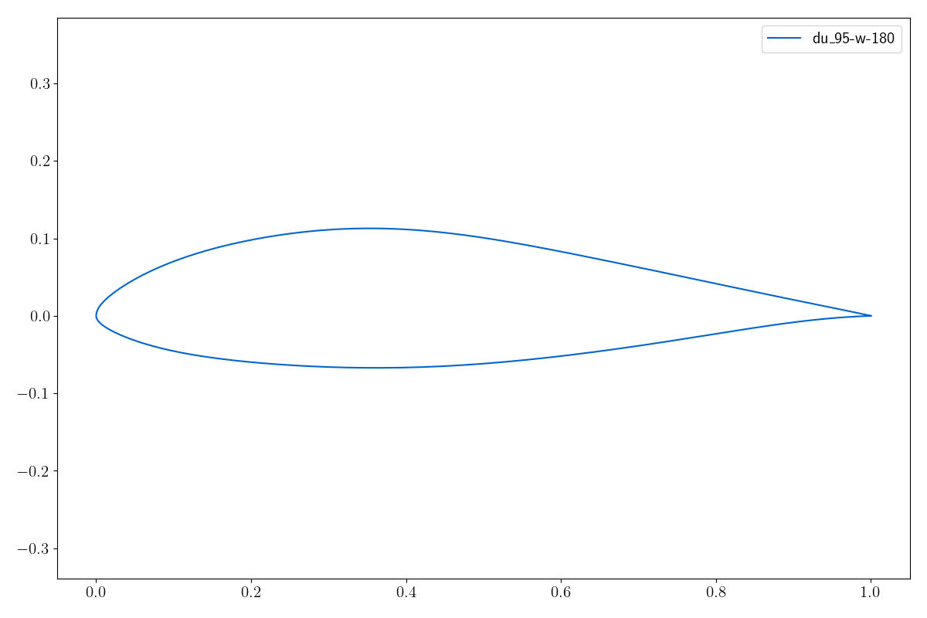
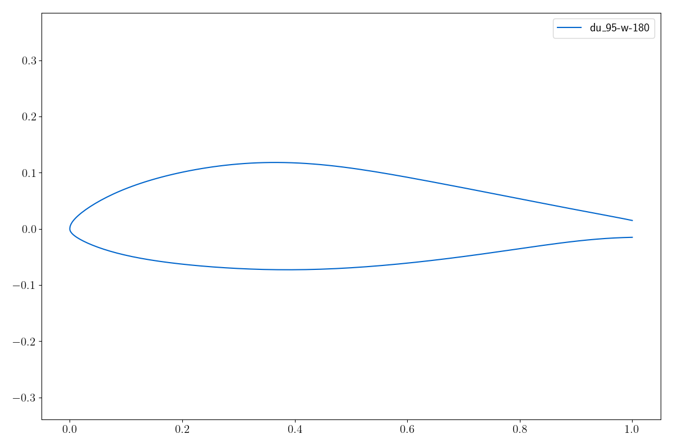
Robustness to Finite Thickness Trailing Edges
Design Requirement
Will be designing sharp since true TE gap cannot be known a priori
Target less than 1% change in all metrics on the following thicknesses:
Thickness targets increase for thicker inboard airfoils
Normalized Thickness | 15% | 18% | 21% | 24% | 27% | 30% | 33% | 36%
TE Gap | 2mm | 2mm | 2mm | 3mm | 3.5mm | 4mm | 4.5mm | 5mm
TE Gap

Slide 46
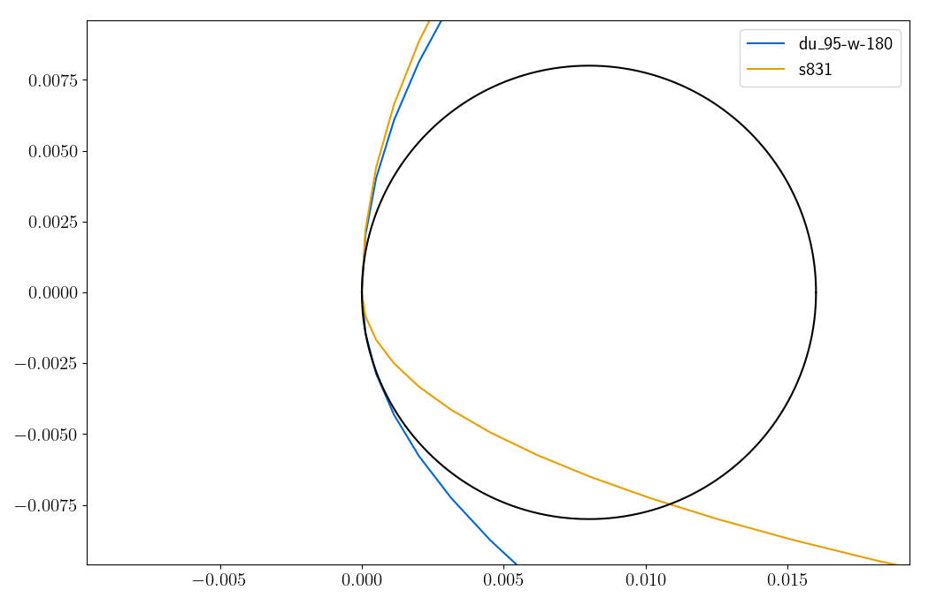
Leading Edge Radius
Design Requirement
Small LE radius causes inconsistent and rapid separation
Limit to somewhere between the DU and S series airfoils
Normalized Thickness | 15% | 18% | 21% | 24% | 27% | 30% | 33% | 36%
LE Radius | 0.007 | 0.008 | 0.01 | 0.025 | 0.03 | 0.04 | 0.06 | 0.08
R=0.008

Slide 47
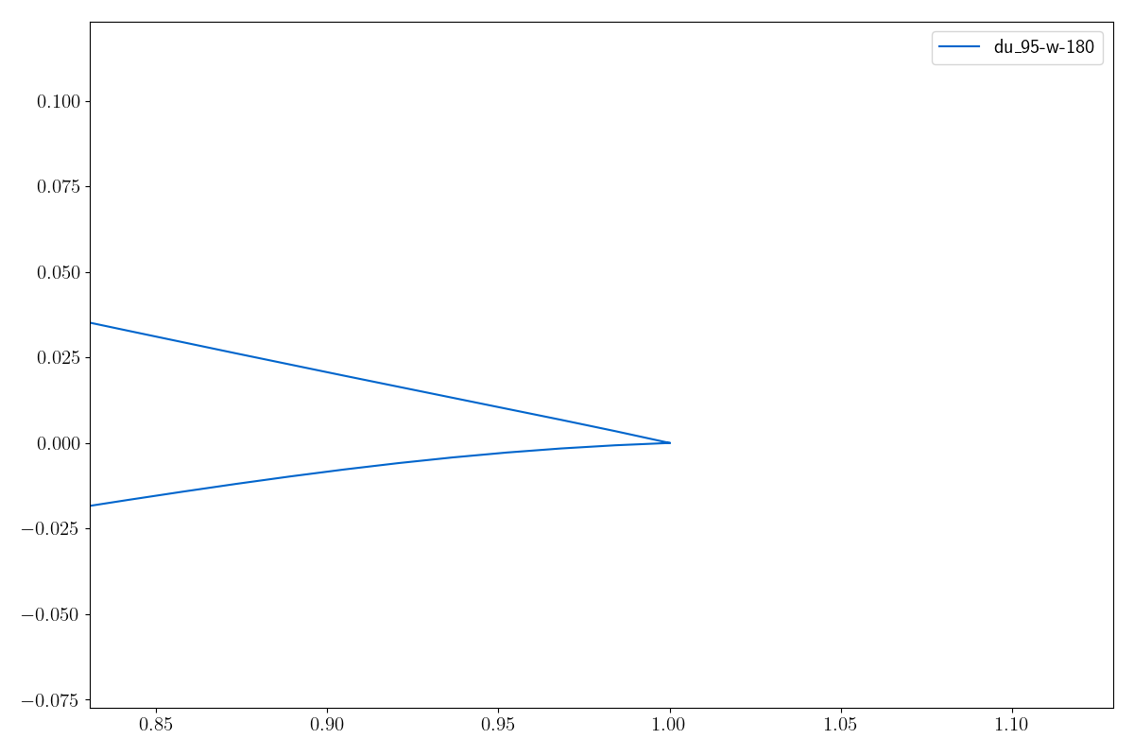
Trailing Edge Wedge Angle
Design Requirement
Ensures manufacturability and structural integrity
Last 2% of chord must have a wedge angle of at least 10 degrees
10º
0.98

Slide 48
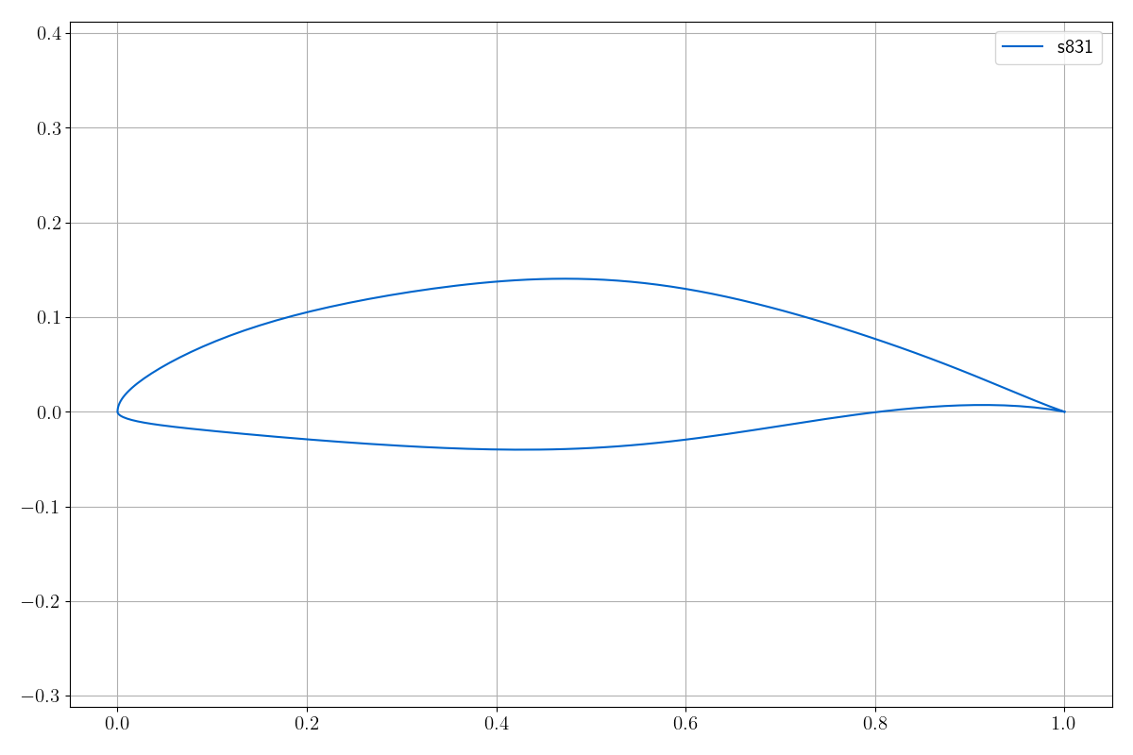
Maximum Thickness Location
Design Requirement
S-series airfoils had significant spar offsets
Will constrain max thickness to occur at the same x/c in this work
Line connecting the two max thickness locations should not be slanted
Notes:
Will do lofting of airfoils on actual 3D blade model at each design iteration stage as a higher fidelity check.
Impacts structural performance.

